Slide 1
云计算技术
陈果 副教授
湖南大学-信息科学与工程学院-计算机与科学系
邮箱：guochen@hnu.edu.cn
个人主页：1989chenguo.github.io

Slide 2
Physical structure
Part I: Cloud networking
Most materials from UIUC MOOC
Ankit Singla
ETH Zürich
P. Brighten Godfrey
UIUC
Indranil Gupta
UIUC
Credits to

Slide 3
Scale of Cloud

Slide 4
Massive scale
Facebook [GigaOm, 2012]
30K in 2009 -> 60K in 2010 -> 180K in 2012
Microsoft [NYTimes, 2008]
150Kmachines
Growth rate of 10K per month
80K total running Bing
Yahoo! [2009]
100K
Split into clusters of 4000
AWS EC2 [Randy Bias, 2009]
40,000 machines
8 cores/machine
eBay [2012]: 50K machines
HP [2012]: 380K in 180 DCs
Google: A lot

Slide 5
Latest cloud scale
Microsoft Azure as an example
Let me show you something real!

Slide 6
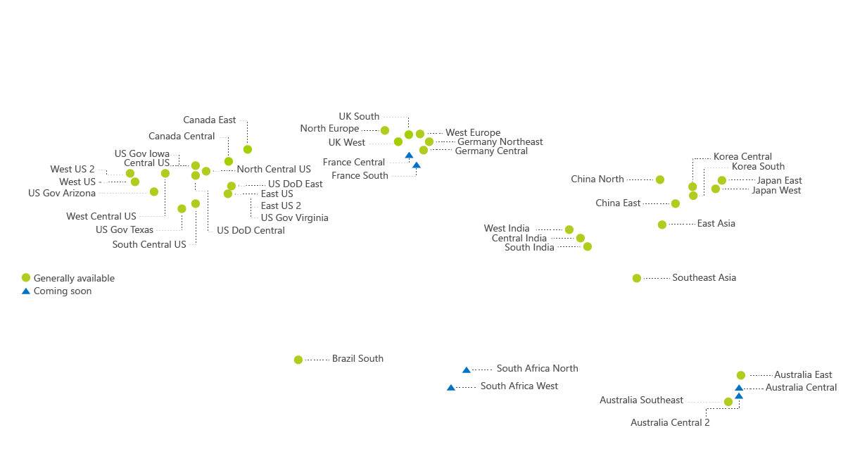
Microsoft Cloud Network

Slide 7
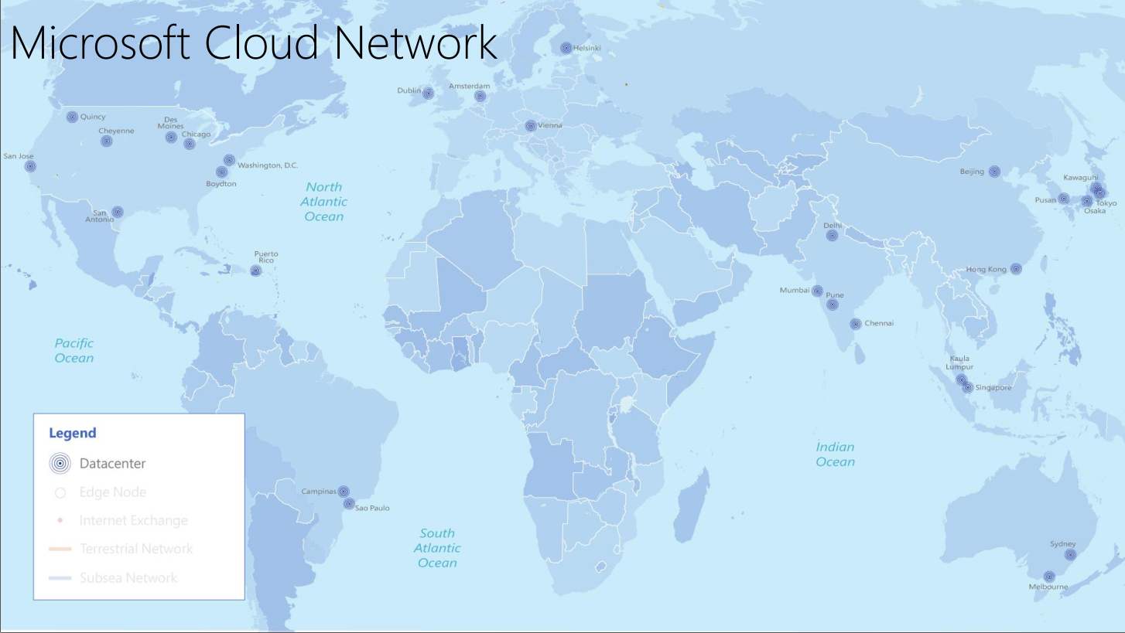

Slide 8
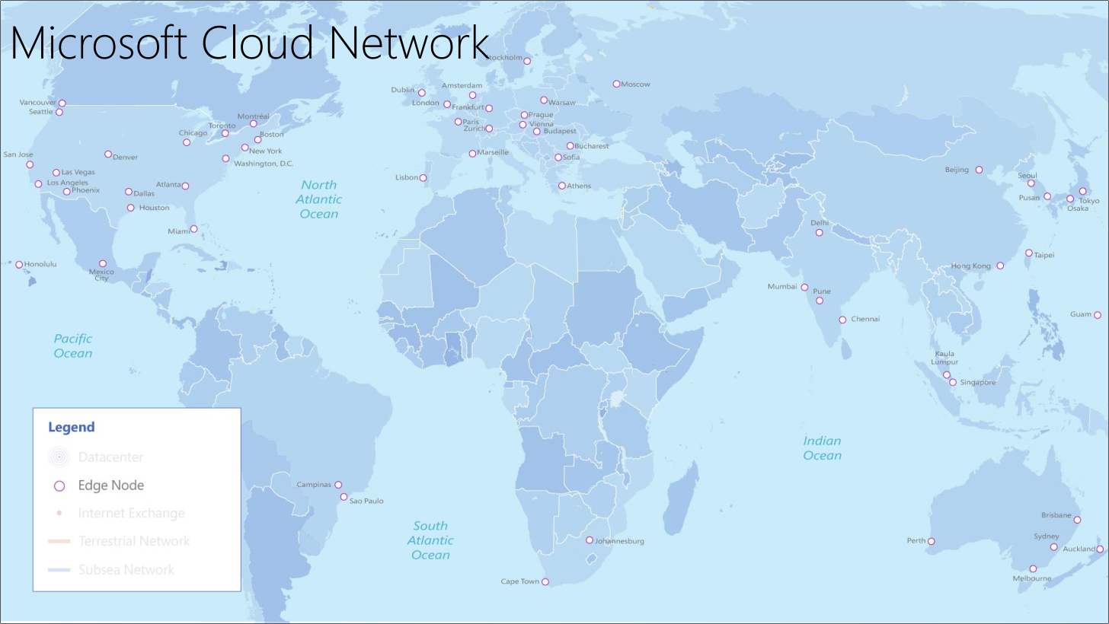

Slide 9
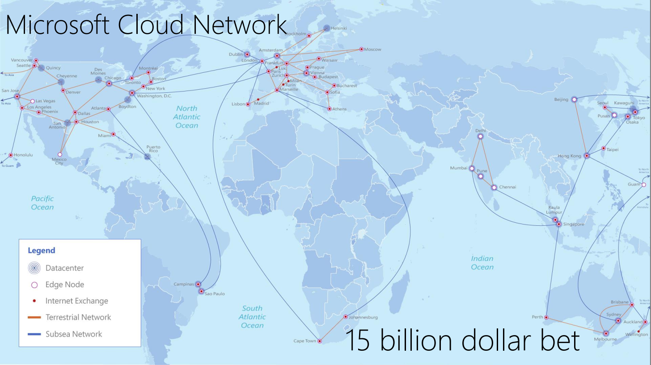

Slide 10
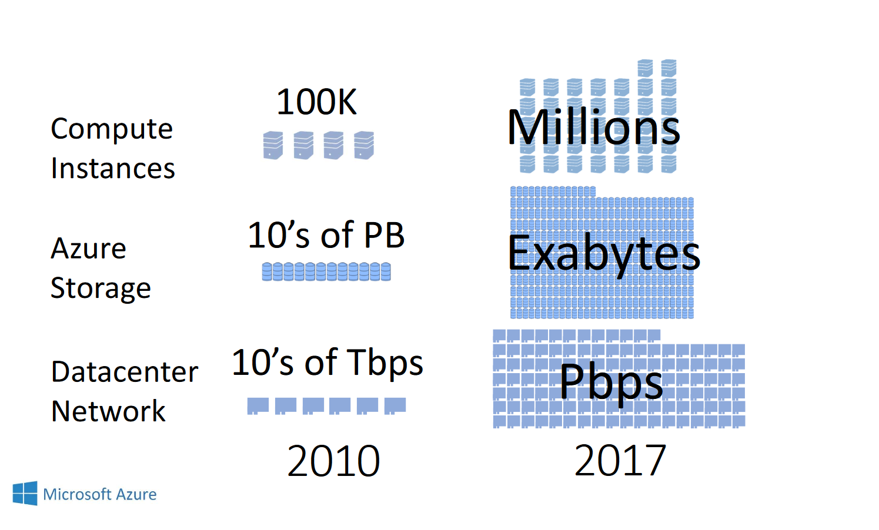

Slide 12
What Cloud Physically Looks Like
Some interesting pictures & videos!

Slide 13
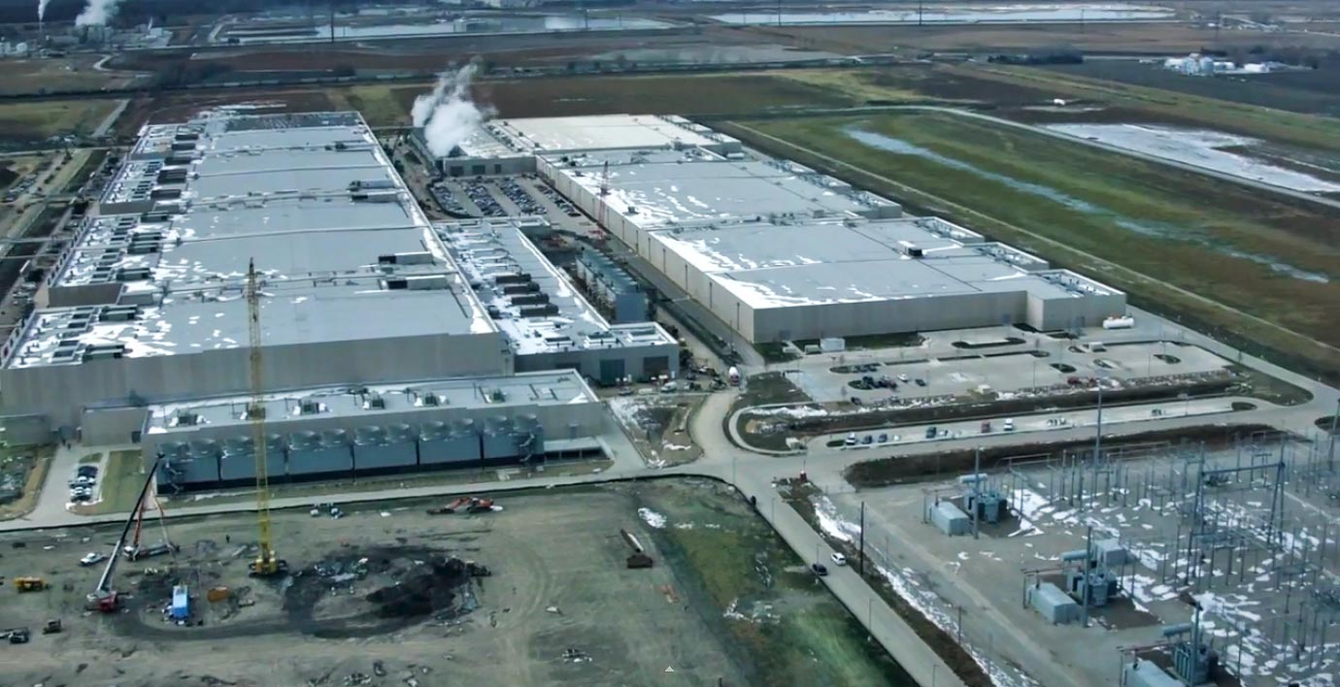
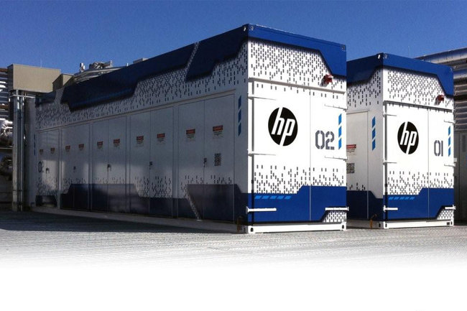
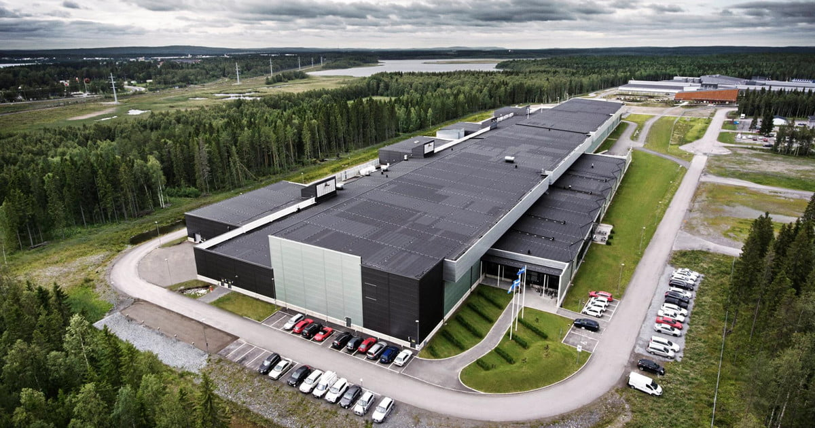
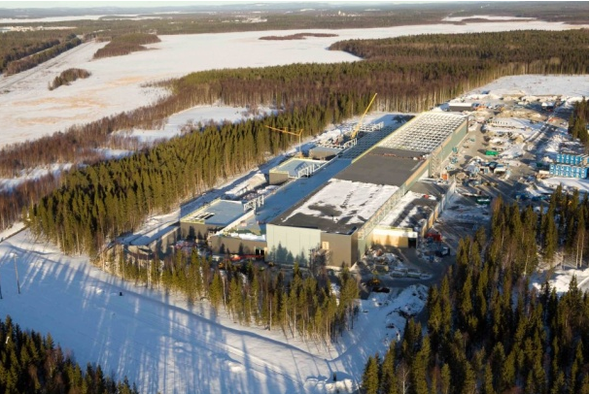
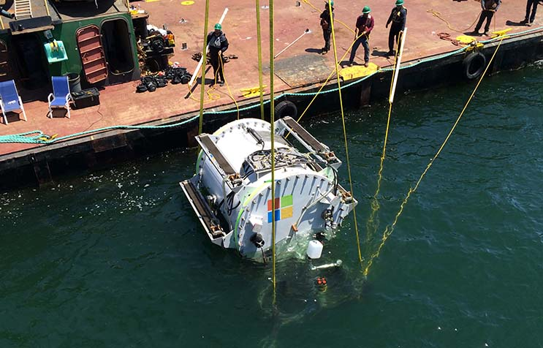
Building
[Image: Derrick Coetzee]
Notes:
… such as this one. Actually … this is just a shopping mall in San Francisco; BUT it’s smaller in size than the largest data centers, and more of you have probably been inside a mall than inside a massive data center, so it hopefully gives you a better sense of the scale of these facilities.
Image: https://en.wikipedia.org/wiki/Westlake_Shopping_Center#/media/File:Aerial_view_of_Westlake_Shopping_Center,_San_Francisco.jpg

Slide 14
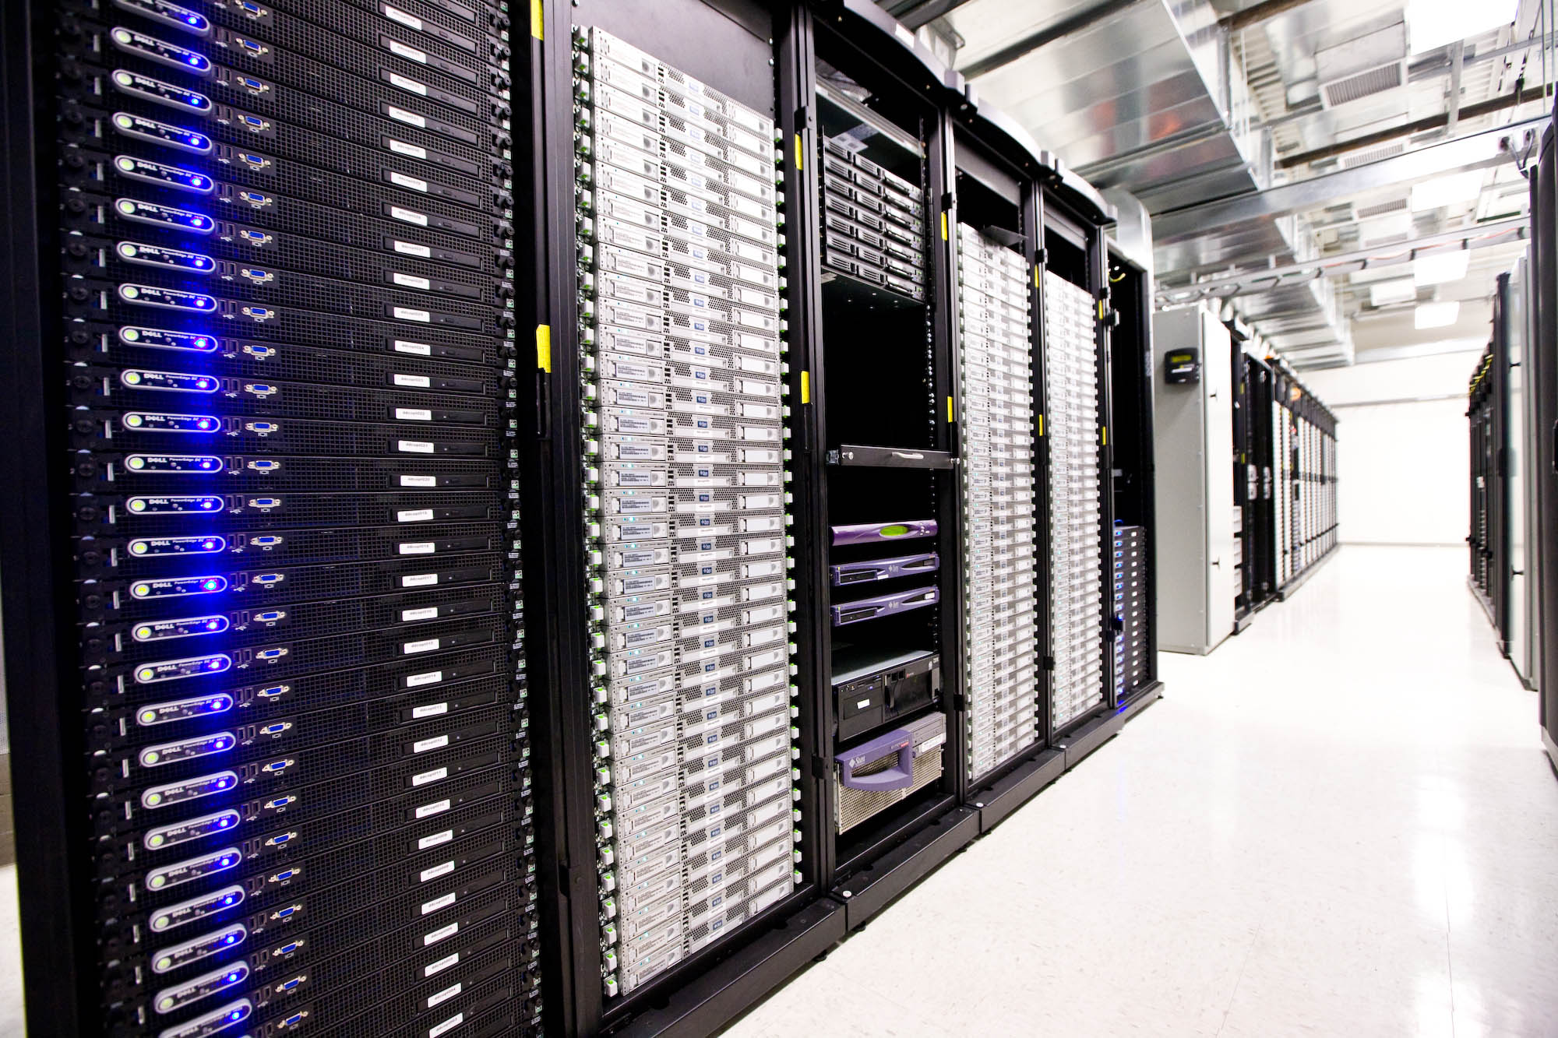
Servers: Front

Slide 15
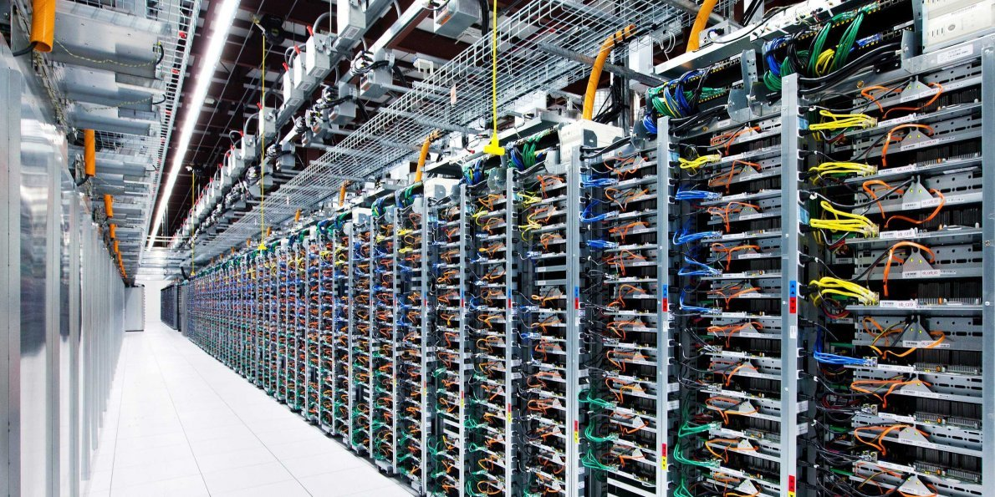
Servers: Back

Slide 16
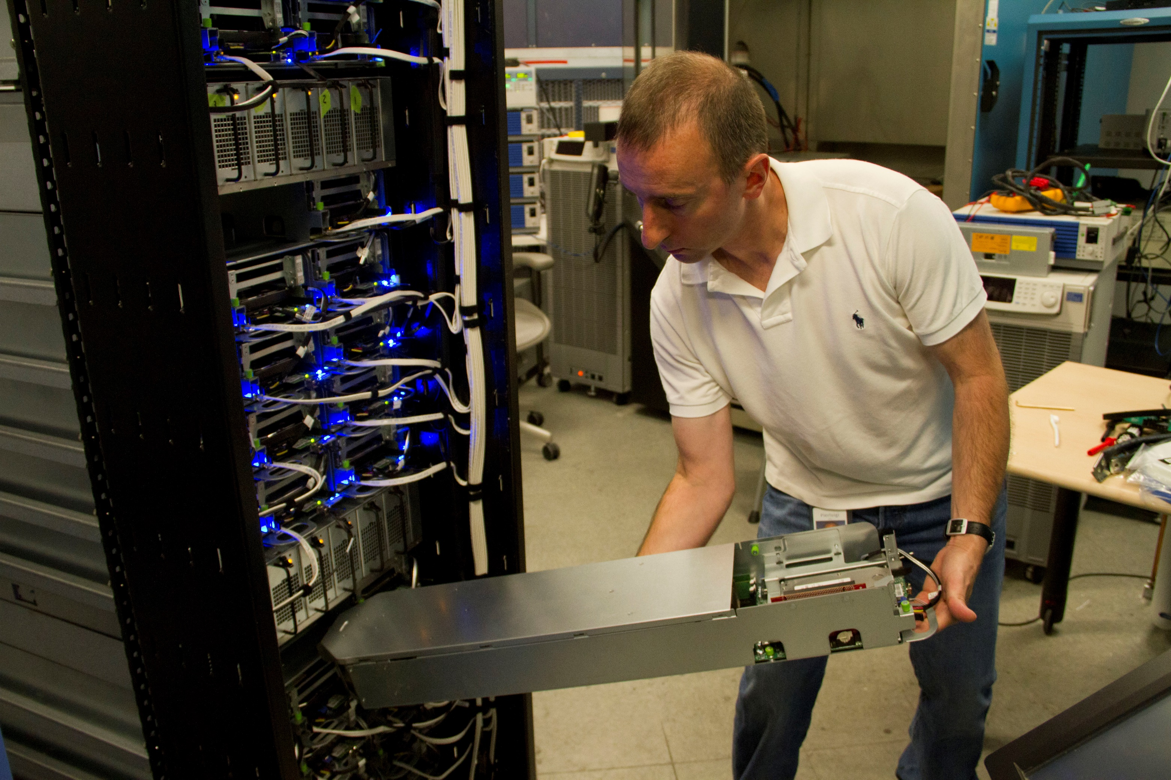
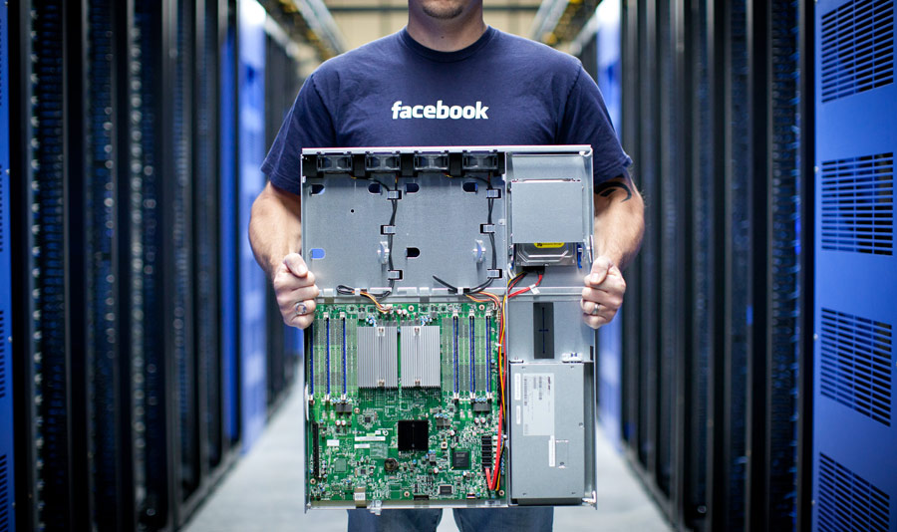
Servers: Inside

Slide 17
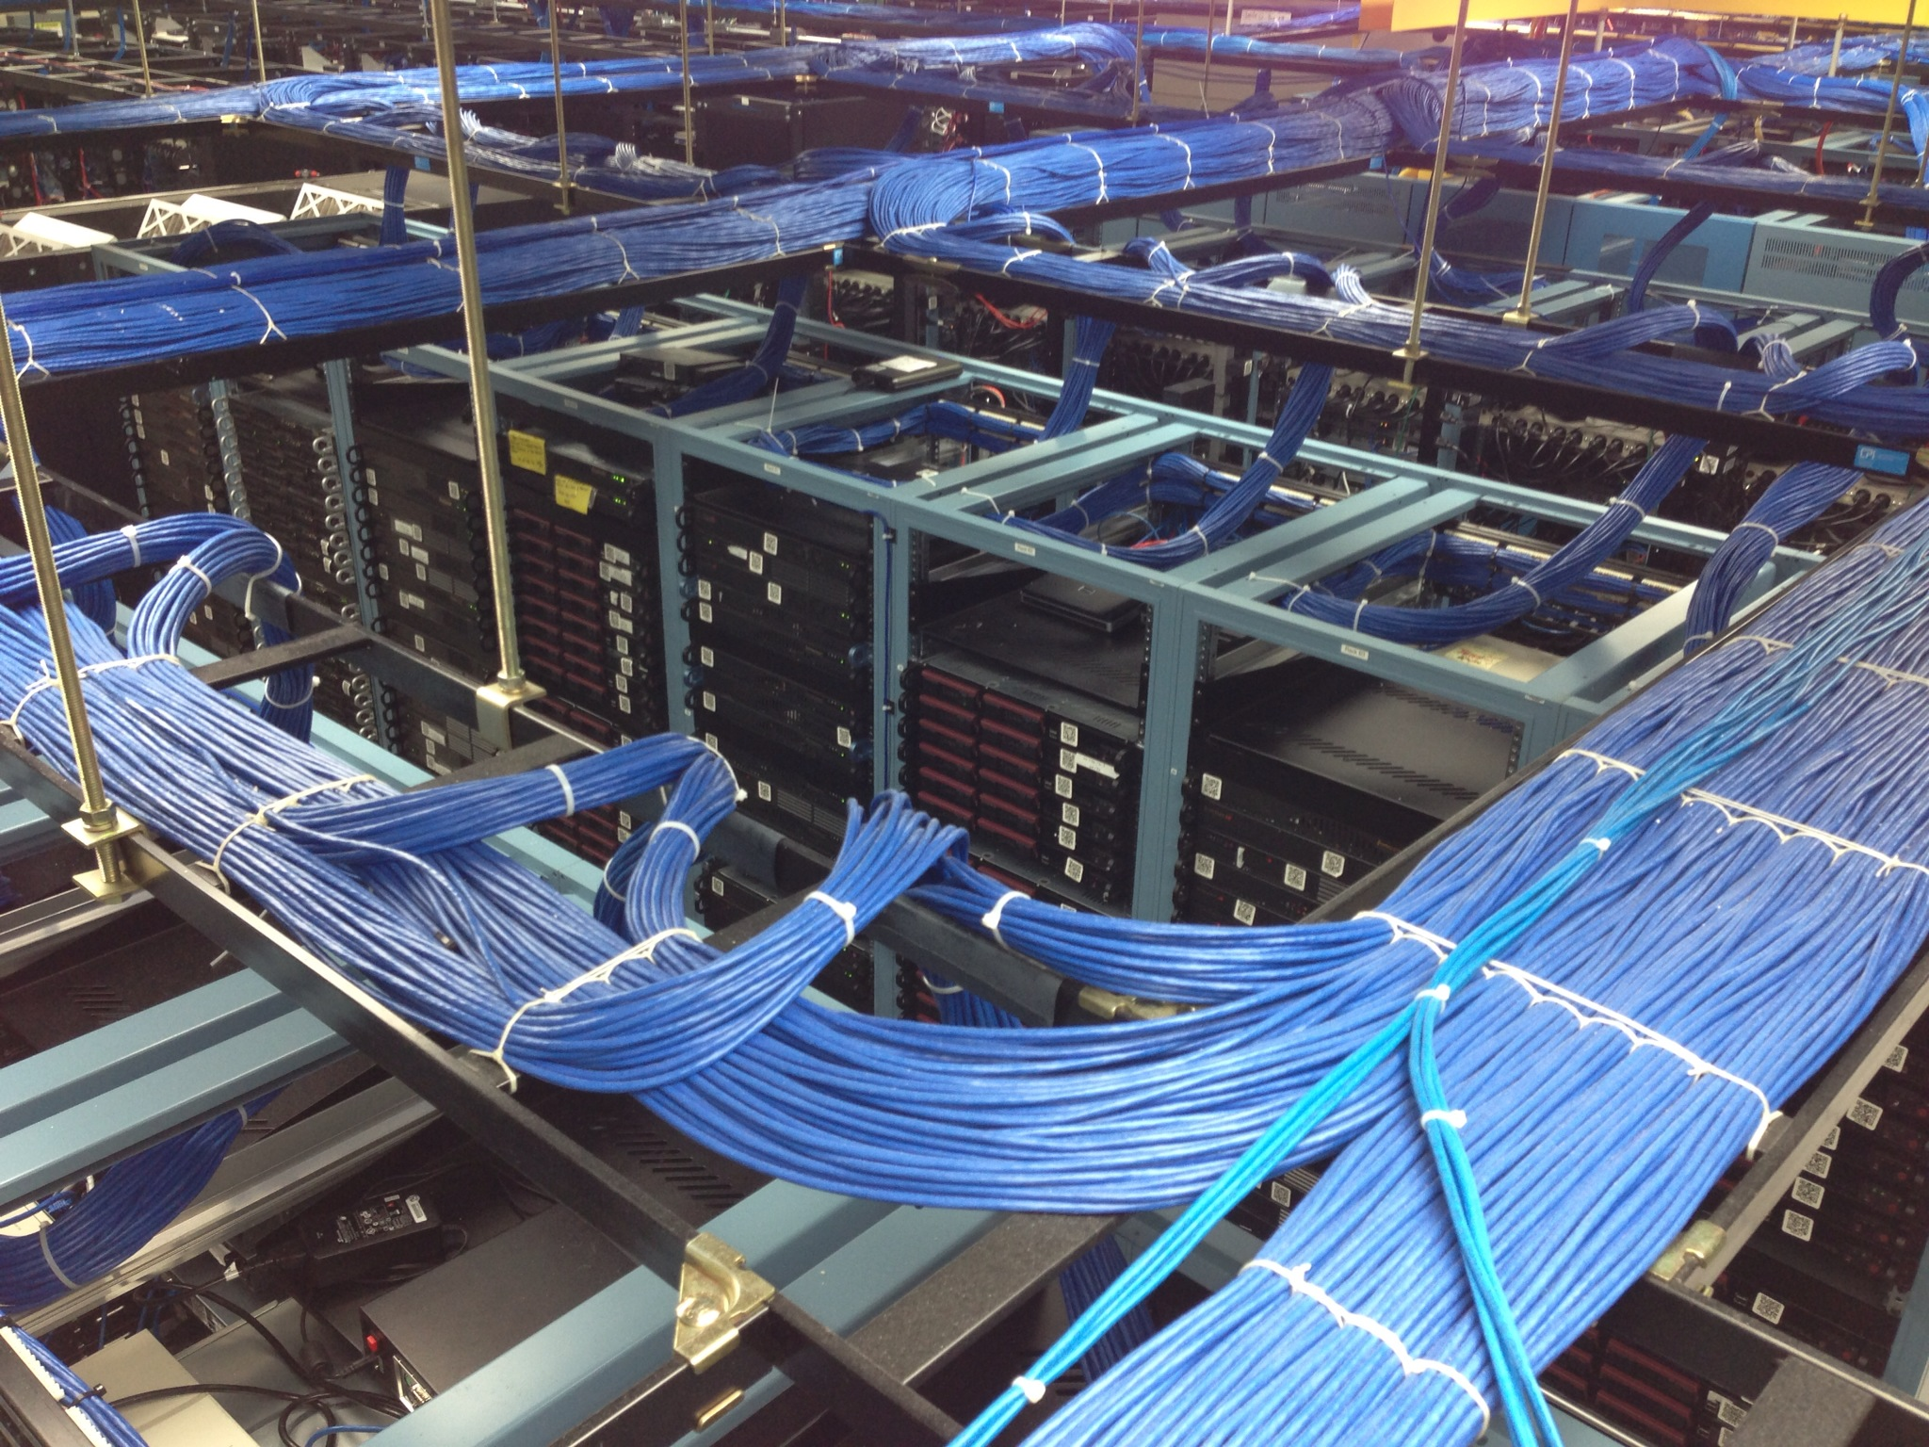
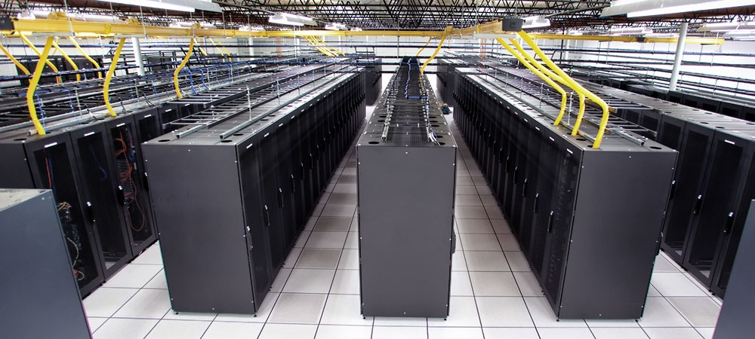
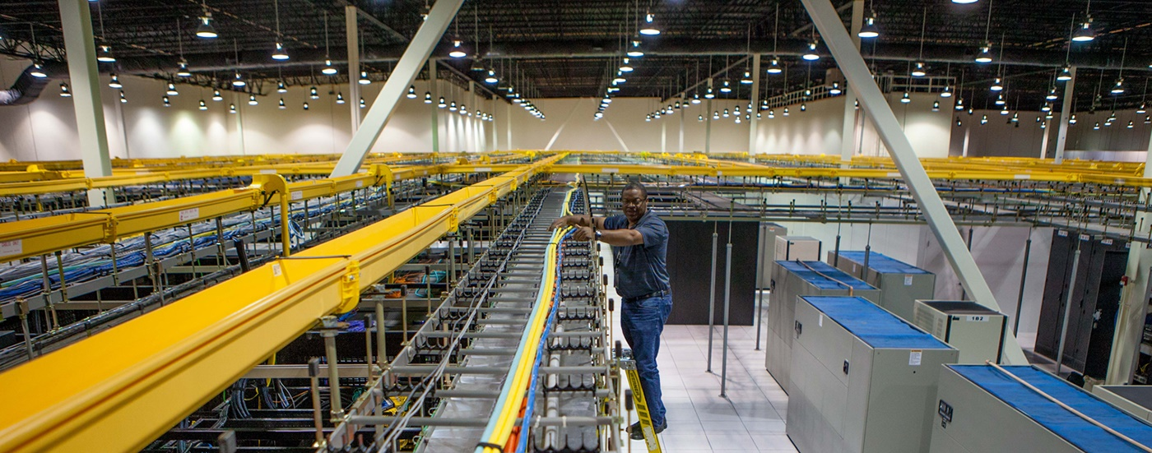
Servers: Network

Slide 18
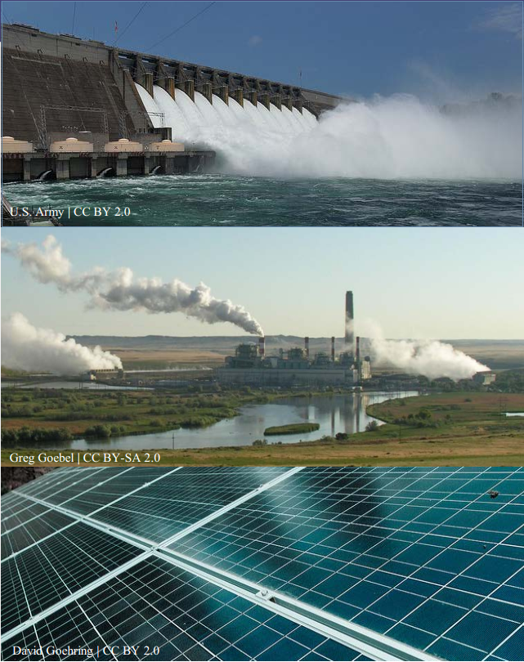
Power
WUE = Annual Water Usage / IT Equipment Energy (L/kWh)
low is good
PUE = Total Facility Power / IT Equipment Power
low is good
e.g., Google = 1.11
Off-site
On-site

Slide 19
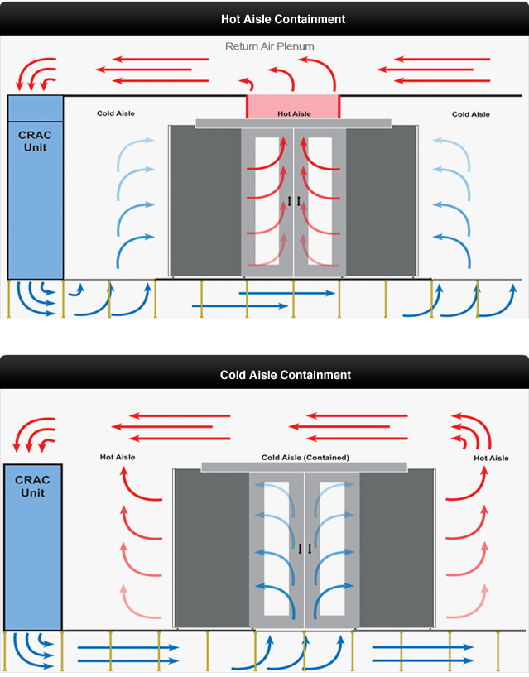
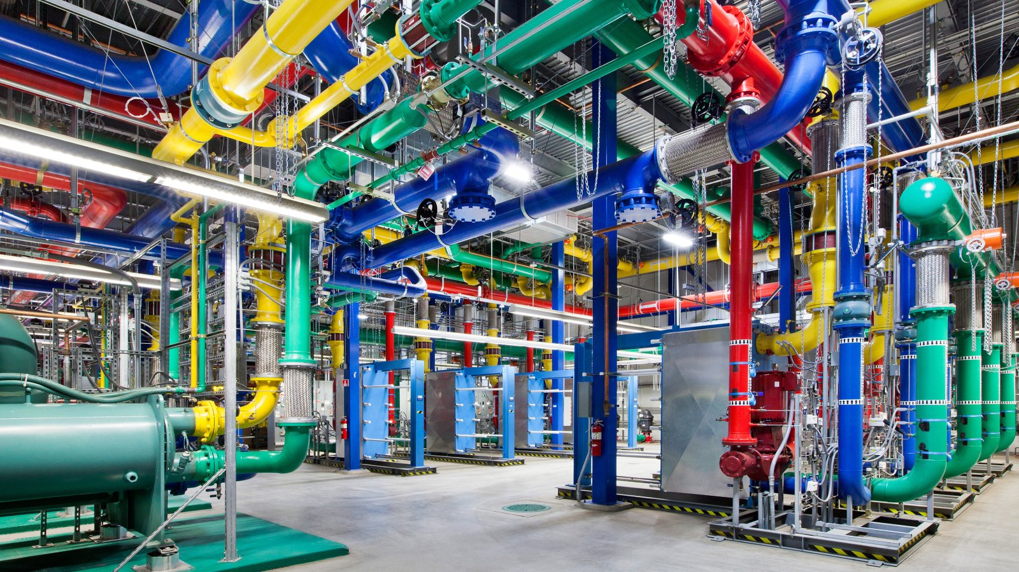
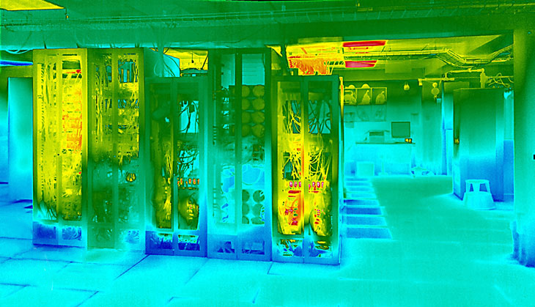
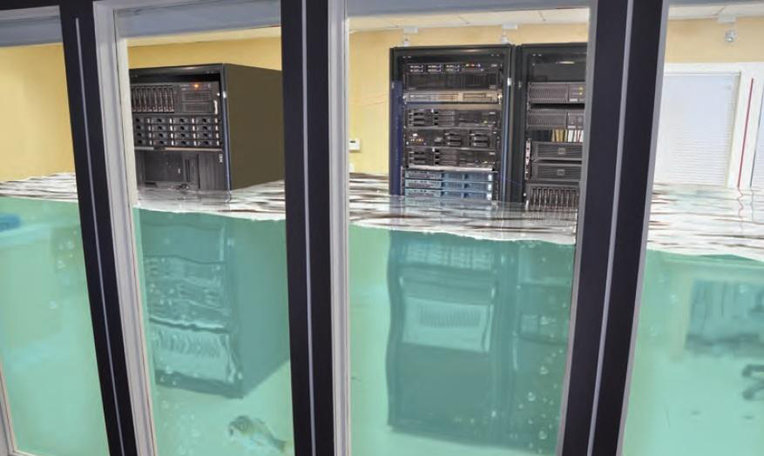
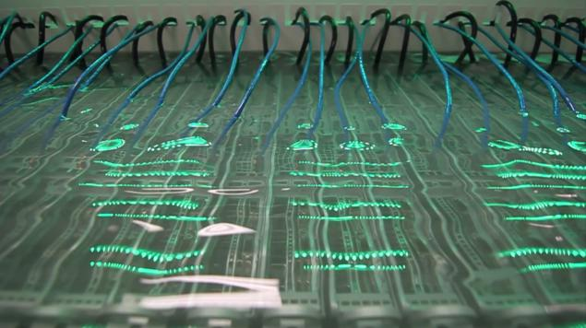
Cooling

Slide 20
Let’s explore in Google’s data center

Slide 21
Data center network topology
Something more serious now ☺

Slide 22
A server rack
A top-of-rack switch
A rack of servers
Notes:
In the manner you just saw, servers are typically stacked into racks, for various reasons, including space efficiency and management ease. Servers in each rack are connected to a top-of-rack network switch.
ToR supports full line-rate communication between all its ports.

Slide 23
Lots of racks
How to network
the racks?
Facebook: machine-machine traffic “doubling at an interval of less than a year”
Notes:
The data center is composed of a large number of such racks, which are then connected into a network. The network’s task is to enable these servers to work together on big data problems. If the network doesn’t provide enough capacity, the compute tasks are bottlenecked, waiting for data from other tasks.
Increasingly, traffic internal to data centers is much more voluminous than …
Further, this need for bandwidth is growing: Facebook, for example, has noted that …

Slide 24
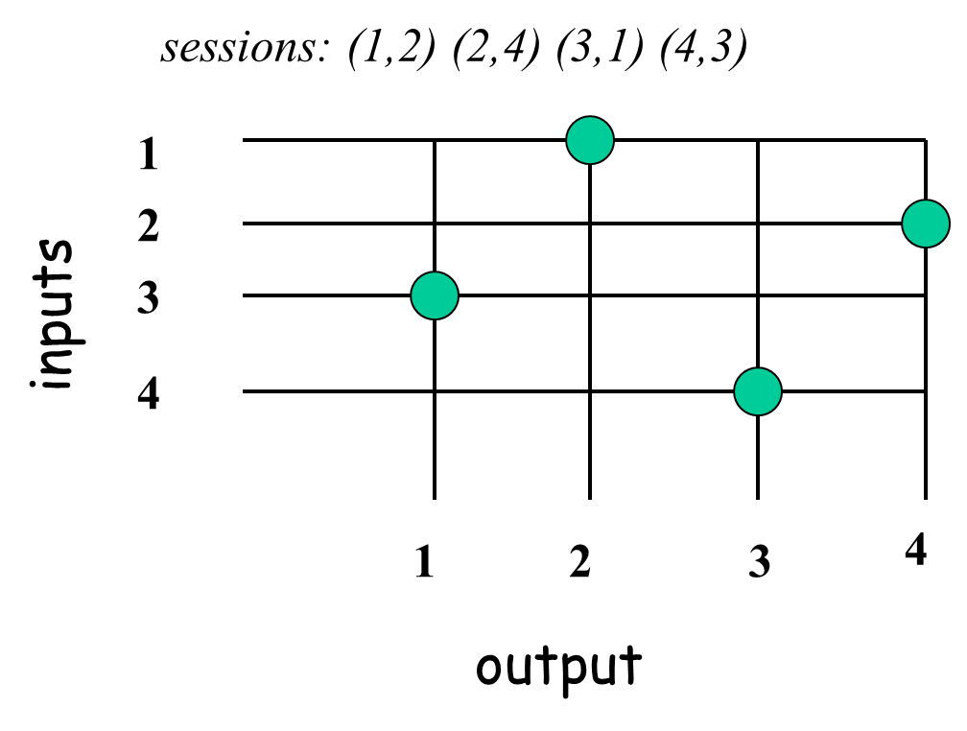
“Big switch” approach
From Prof. Constantine Dovrolis, GaTech
Big crossbar
…
Notes:
What we really want: a big crossbar
Why can’t we literally do this? n² connections
Well, we could … to a limited scale.

Slide 25
“Big switch” approach
…
Notes:
Although, perhaps we’d use multiple big switches for capacity and redundancy … Designs along these lines were in fact built!

Slide 26
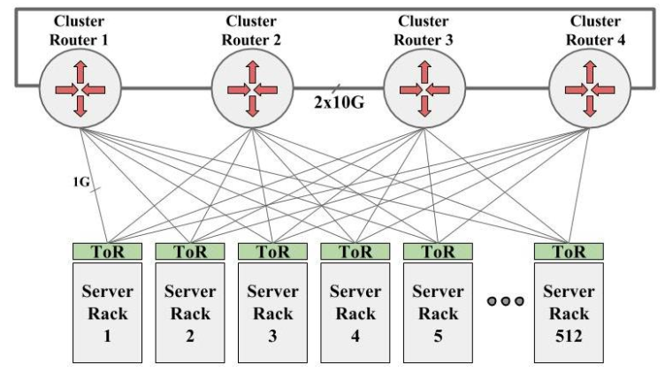
512 ports x 1G
4 ports x 1G
40 servers x 1G
Notes:
2004 design @ Google. A similar design was deployed @ Facebook as well.
traffic HAS to be very local. Otherwise, if all 40 servers in rack want to go out …

Slide 27
“Big switch” approach
$$$$$
$$$$$
$$$$$
$$$$$
…
Notes:
expensive
specialized, few vendor choices
proprietary tech, special-purpose management interfaces, inflexible
next gen line-speed won’t become available at same density
but perhaps the most serious limitation: scalability

Slide 28
Alternative: tree network
Notes:
hierarchy of switches of increasing size
well, this isn’t a tree …

Slide 29
Alternative: tree network
Notes:
rather … tree + redundancy

Slide 30
Alternative: tree network
$$$
$$$
Congestion
Notes:
trade-off between scale and capacity
And as machine-machine traffic increases, problems occur
restricts application deployment and traffic patterns
poor fault recovery
still suffers from similar problems

Slide 31
Clos networks to the rescue
Notes:
1950s for telephone system (same driver: crossbar doesn’t scale!)
support arbitrary permutation of inputs and outputs
e.g. here is an 8-ary Clos network
notice the key difference from the tree approach (small sw)

Slide 32
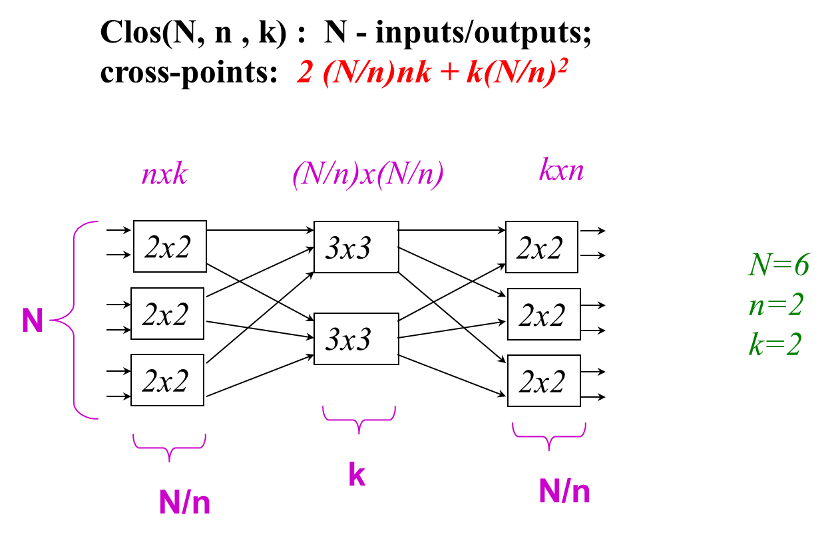
Clos network
From Prof. Constantine Dovrolis, GaTech

Slide 33
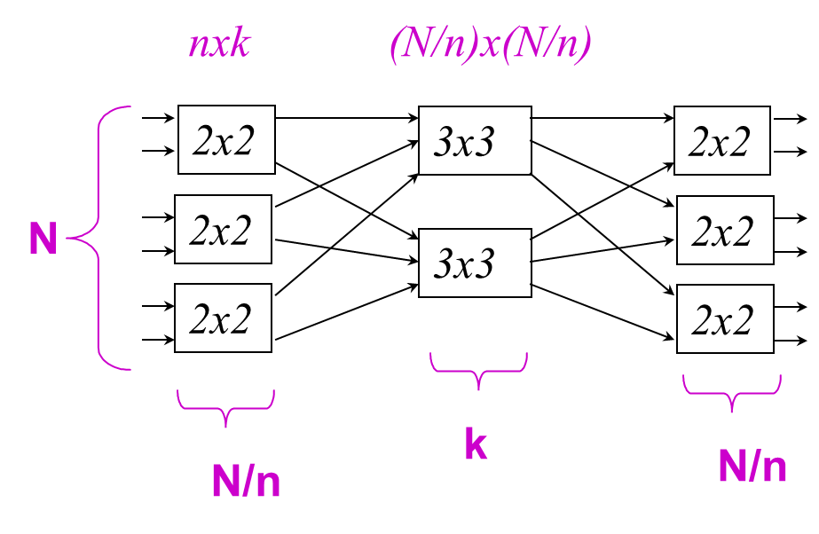
Clos network
Non-blocking types
Re-arrangeable non-blocking
Can route any permutation from inputs to outputs.
Strict sense non-blocking
Given any current connections through the switch, any unused input can be routed to any unused output.
Strict sense non-blocking
If k ≥ 2n-1
Re-arrangeable non-blocking
If k ≥ n

Slide 34
Clos networks to the rescue
Use small, cheap elements to build large capacity-rich networks
Notes:
1950s for telephone system (same driver: crossbar doesn’t scale!)
support arbitrary permutation of inputs and outputs
e.g. here is an 8-ary Clos network
notice the key difference from the tree approach (small sw)

Slide 35
Clos networks to the rescue
Notes:
1950s for telephone system (same driver: crossbar doesn’t scale!)
support arbitrary permutation of inputs and outputs
e.g. here is an 8-ary Clos network
notice the key difference from the tree approach (small sw)

Slide 36
Clos networks to the rescue
Notes:
1950s for telephone system (same driver: crossbar doesn’t scale!)
support arbitrary permutation of inputs and outputs
e.g. here is an 8-ary Clos network
notice the key difference from the tree approach (small sw)

Slide 37
Clos networks to the rescue
Notes:
1950s for telephone system (same driver: crossbar doesn’t scale!)
support arbitrary permutation of inputs and outputs
e.g. here is an 8-ary Clos network
notice the key difference from the tree approach (small sw)

Slide 38
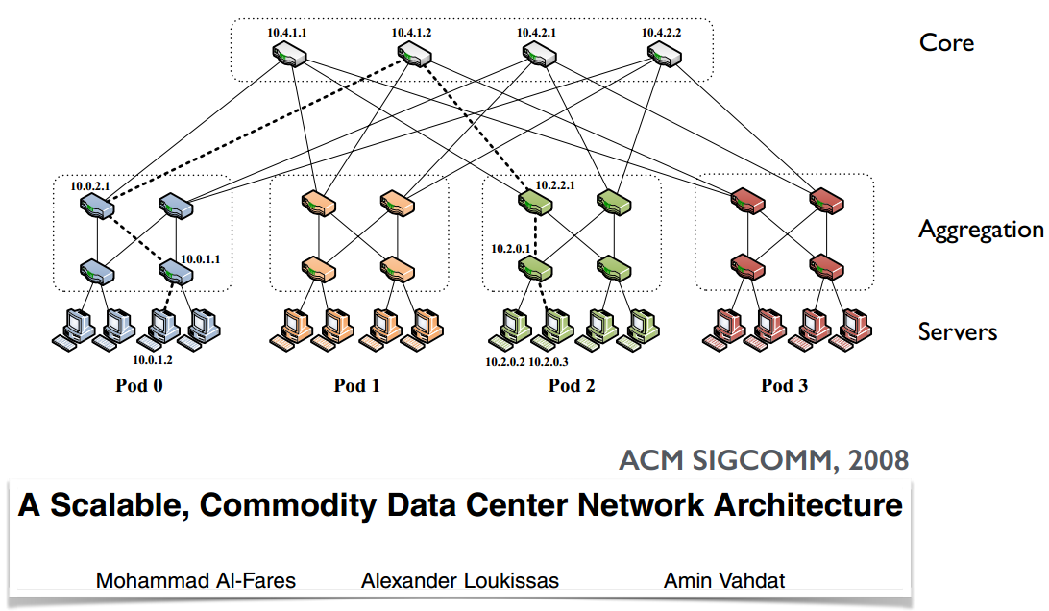
Fat-tree network
Notes:
“folded” Clos network
built from small switches throughput
can be built to large sizes
with 96-port switches, one can build a fat-tree with more than 200k servers
trying to achieve what the tree-hierarchy fails to achieve

Slide 39
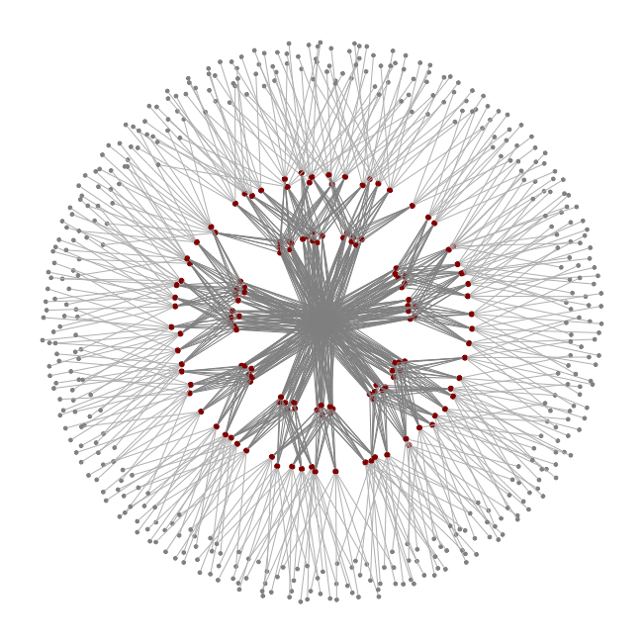
Fat-tree network
Notes:
a visualization of a fat-tree with a few hundred servers

Slide 40
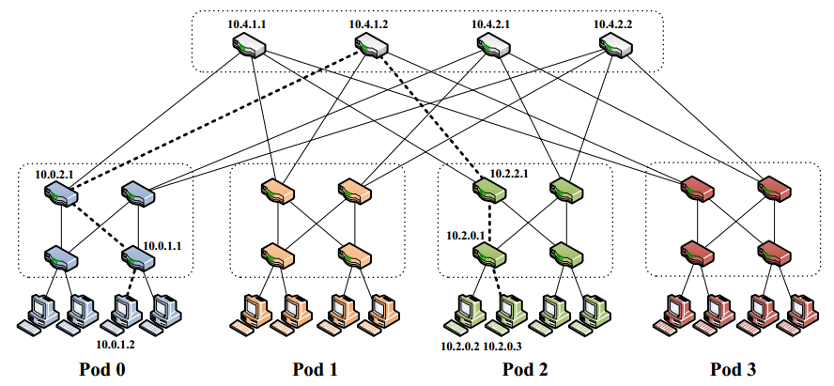
Fat-tree network
Notes:
lots of redundant paths

Slide 41
Fat-tree network
x Gbps
x Gbps
Notes:
full capacity

Slide 42
Fat-tree network
x
x
x
_
Gbps
2
x Gbps
Notes:
but can also “oversubscribe”
local clusters may have higher capacity
these can be looked at as “placement groups”

Slide 43
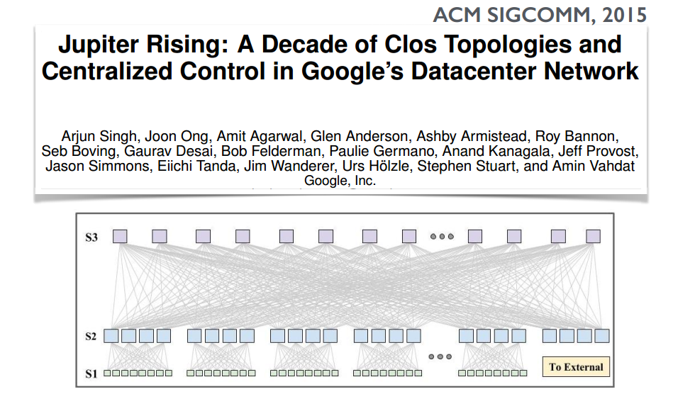
Notes:
cable aggregation
notice also the external connectivity

Slide 44
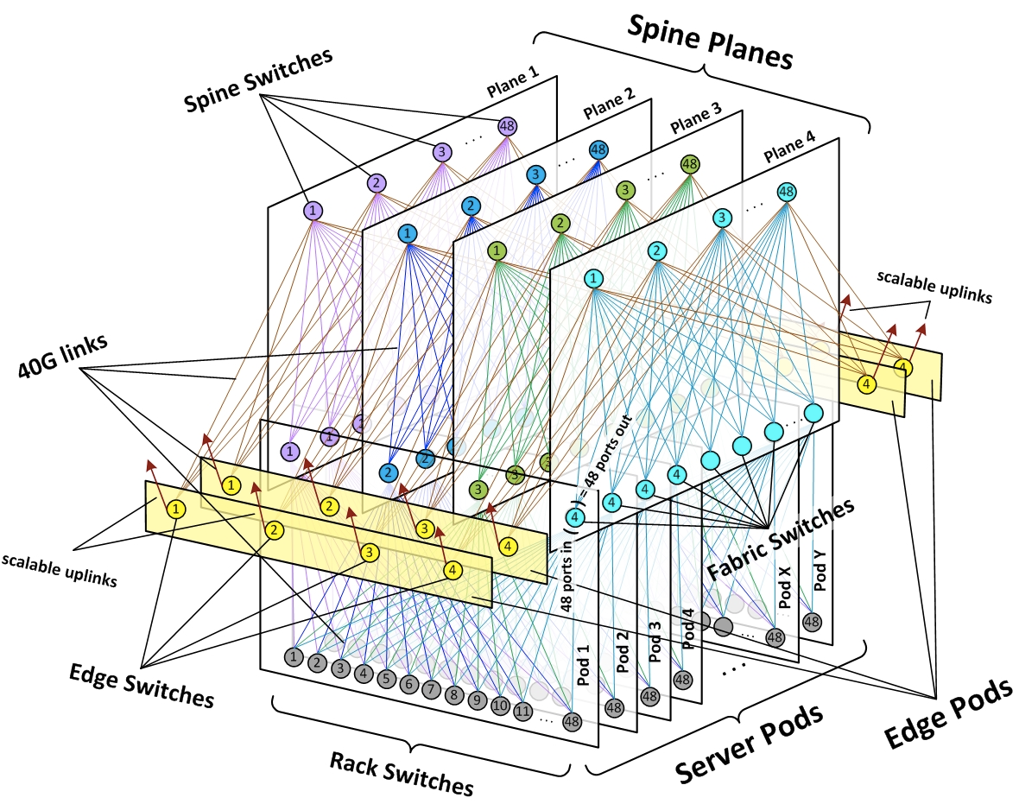
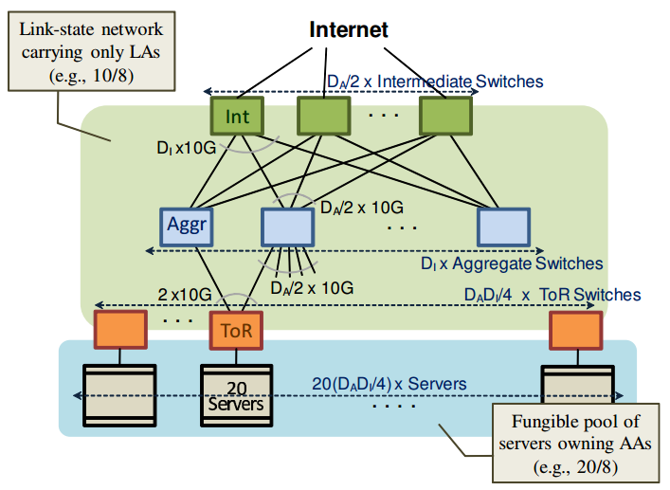
Variants of this design are common
VL2 @ Microsoft, ACM SIGCOMM’09
Greenburg, Hamilton, Jain, Kandula, Kim, Lahiri, Maltz, Patel, Sengupta
“Introducing data center fabric, the next-generation Facebook
data center network”, Alexey Andreyev, 2015
Notes:
Variants of this design are common:
MS
Facebook
So, several big players have converged to the same design

Slide 45
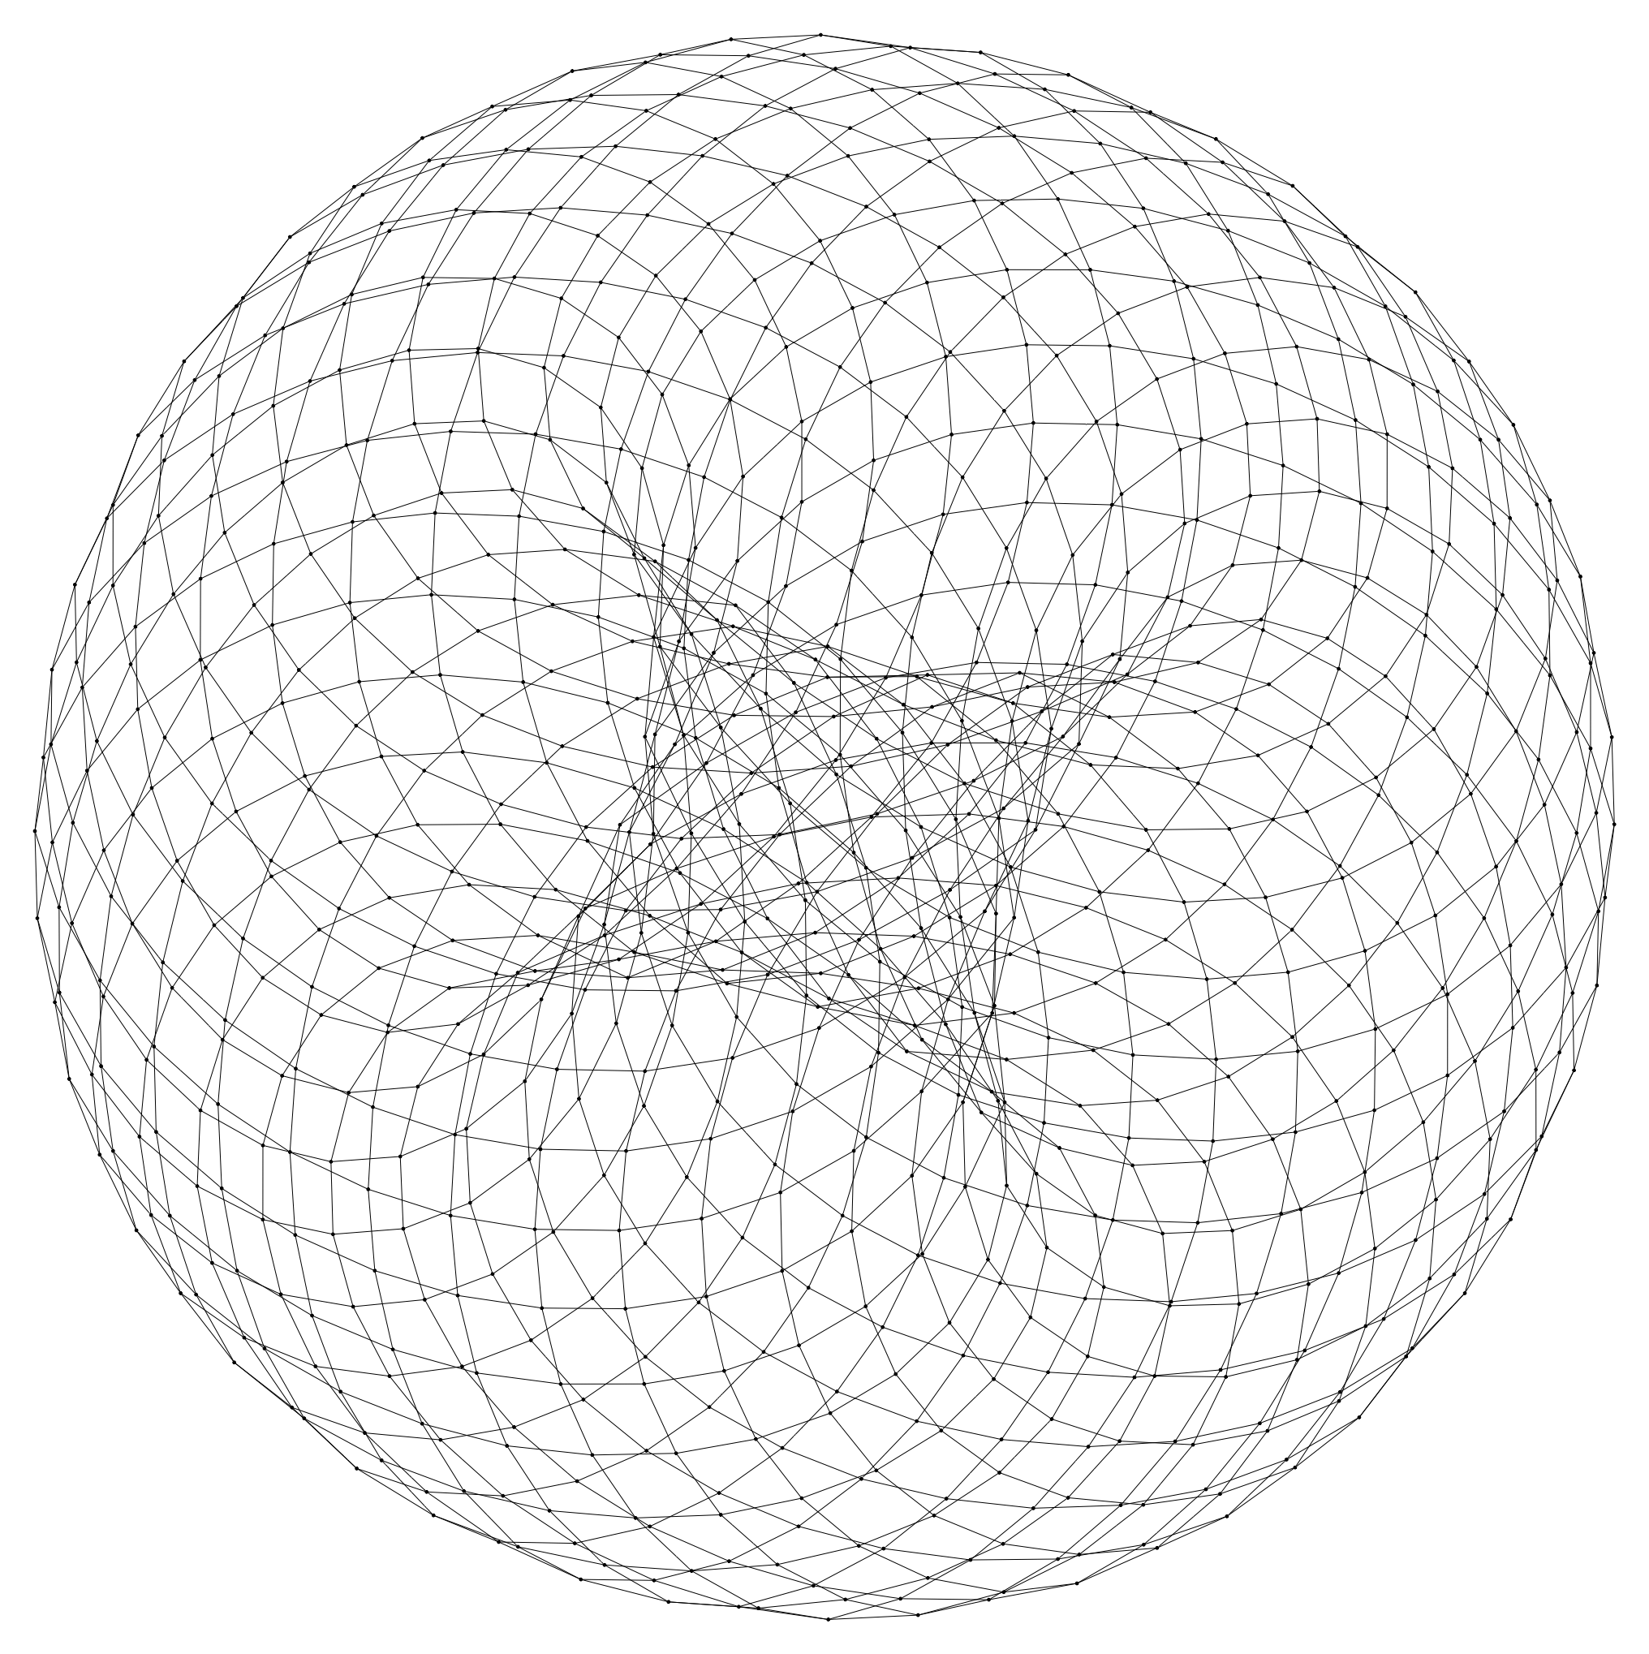
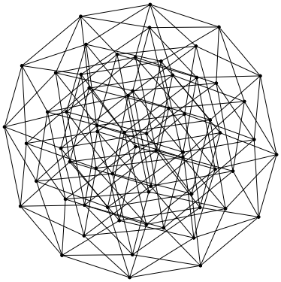
There are other design possibilities too
Notes:
Nevertheless, there are other design possibilities too.
3D-Torus used in the Gordon system at San Diego Supercomputer Center
Hypercube in NASA’s Pleiades system
Different tradeoffs with each topology
Wrap: we’ve looked at topo in isolation, but interplay between topo and routing.

Slide 46
Video: Introduction to Facebook's data center fabric

Slide 47
Reading materials for group projects
“Jupiter Rising: A Decade of Clos Topologies and Centralized Control in Google's Datacenter Network”, SIGCOMM 2015
“PortLand: A Scalable Fault-Tolerant Layer 2 Data Center Network Fabric”, SIGCOMM 2009 + “A Scalable, Commodity Data Center Network Architecture”, SIGCOMM 2008
“VL2: A Scalable and Flexible Data Center Network”, SIGCOMM 2009
“BCube: A High Performance, Server-centric Network Architecture for Modular Data Centers”, SIGCOMM 2009
“Beyond fat-trees without antennae, mirrors, and disco-balls”, SIGCOMM 2017
“A Tale of Two Topologies: Exploring Convertible Data Center Network Architectures with Flat-tree”, SIGCOMM 2017
“High Throughput Data Center Topology Design”, NSDI 2014 + “Jellyfish: Networking Data Centers Randomly”, NSDI 2012
“Introducing data center fabric, the next-generation Facebook data center”, https://code.facebook.com/posts/360346274145943/introducing-data-center-fabric-the-next-generation-facebook-data-center-network/

Slide 48
Thanks!
陈果 副教授
湖南大学-信息科学与工程学院-计算机与科学系
邮箱：guochen@hnu.edu.cn
个人主页：1989chenguo.github.io

