Slide 1
云计算技术
陈果 副教授
湖南大学-信息科学与工程学院-计算机与科学系
邮箱：guochen@hnu.edu.cn
个人主页：1989chenguo.github.io
https://1989chenguo.github.io/Courses/CloudComputing2018Spring.html

Slide 2
What we have learned
What is cloud computing
Cloud Networking
Cloud Distributed System
  Introduction to Cloud Distributed System
    What is cloud distributed system
    What we’ll look at in this part

Slide 3
MapReduce
Part #2: Cloud Distributed System
Most materials from UIUC MOOC
Thanks Indranil Gupta

Slide 4
Outline
Paradigm
Examples
Scheduling
Fault-tolerance

Slide 5
Outline
Paradigm
Examples
Scheduling
Fault-tolerance

Slide 6
What is MapReduce?
“MapReduce is a programming model and an associated implementation for processing and generating big data sets with a parallel, distributed algorithm on a cluster.”
Terms are borrowed from functional language (e.g., Lisp)
  Example: sum of squares
    Map: square (1,2,3,4)
      Output: (1²,2²,3²,4²) = (1,4,9,16)
    Reduce: sum (1,4,9,16)
      Output: (1+4+9+16) = 30
Let’s consider a sample application: WordCount
  You’re given a huge dataset and asked to list the count for each of the words in all the documents
Processes each record independently
Processes (set of) all records in batches

Slide 7
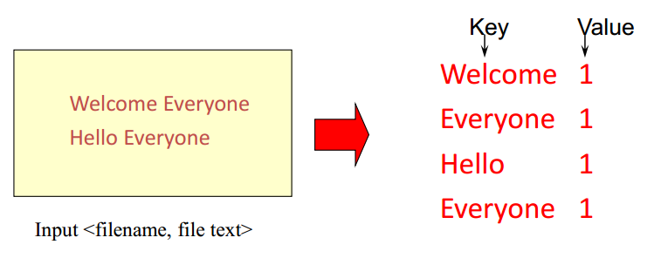
WordCount: Map
Process individual records to generate intermediate key/value pairs

Slide 8
WordCount: Map
Process individual records to generate intermediate key/value pairs in parallel
Map task 1
Map task 2

Slide 9
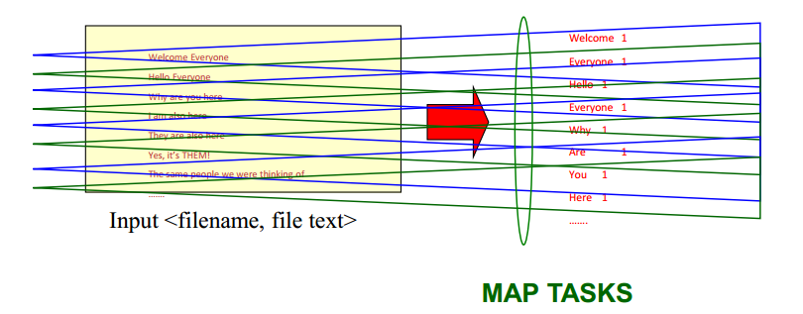
WordCount: Map
Process a large number of individual records to generate intermediate key/value pairs in parallel

Slide 10
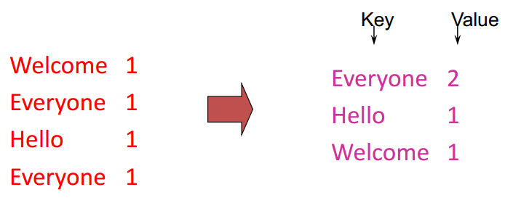
WordCount: Reduce
Processes and merges all intermediate values associated per key

Slide 11
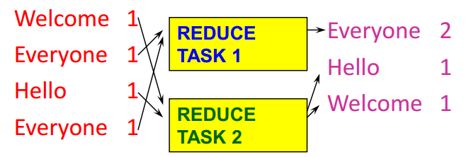
WordCount: Reduce
Each key assigned to one Reduce
Parallelly processes and merges all intermediate values by partitioning keys
Typically: hash partitioning, i.e., key is assigned to
  reduce # = hash(key)%number_of_reduce_servers

Slide 12
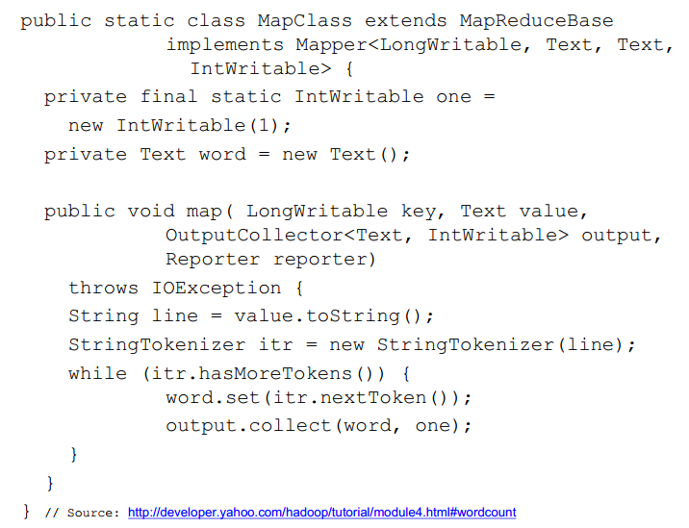
Hadoop code - Map

Slide 13
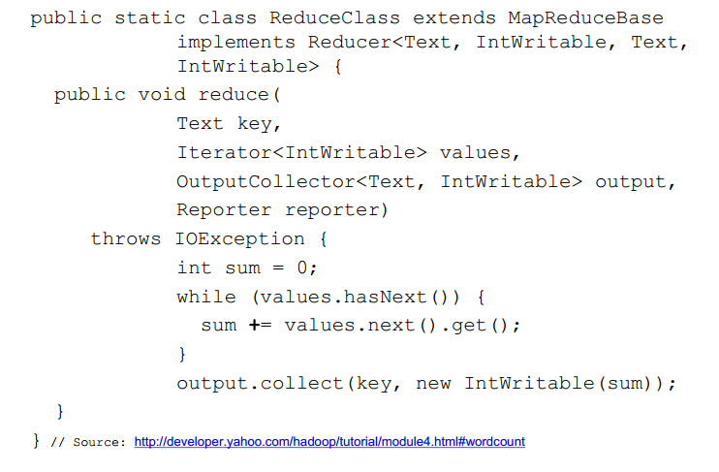
Hadoop code - Reduce

Slide 14
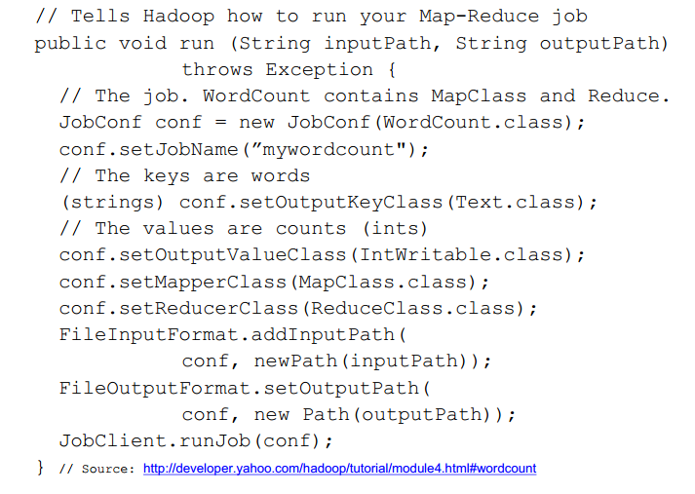
Hadoop code - Driver

Slide 15
Outline
Paradigm
Examples
Scheduling
Fault-tolerance

Slide 16
Some Applications of MapReduce #1
Distributed Grep
  Input: large set of files
  Output: lines that match pattern
Map
  Emits a line if it matches the supplied pattern
Reduce
  Copies the intermediate data to output

Slide 17
Some Applications of MapReduce #2
Reverse Web-Link Graph
  Input:
    Web graph: tuples (a, b) where (page a --> page b)
  Output
    For each page, list of pages that link to it
Map
  For each input <source, target>, output <target, source>
Reduce
  Emits <target, list(source)>

Slide 18
Some Applications of MapReduce #3
Count URL access frequence
  Input:
    Log of accessed URLs, e.g., from proxy server
  Output
    For each URL, % of total accesses for that URL
Map: Output <URL, 1>
Multiple reducers: Emits <URL, URL_count>
Chain another MapReduce jog after above one
Map: Process <URL, URL_count> and output <1, URL_count>
One reducer: Sum up <URL_count> to calculate overall _count
Now we got URL count, but still need %
Get % by URL_count/overall_count

Slide 19
Outline
Paradigm
Examples
Scheduling
Fault-tolerance

Slide 20
Programming MapReduce
Externally: For user
  Write a Map program, write a Reduce program
  Submit job; wait for result
  Need to know nothing about parallel/distributed programming!
Internally: For the Paradigm and Scheduler
  Parallelize Map
  Transfer data from Map to Reduce
  Parallelize Reduce
  Implement storage for Map input/output, Reduce input/output

Slide 21
Inside MapReduce
Parallelize Map
  Easy! Each Map task is independent
Transfer data from Map to Reduce
  All Map output records with same key assigned to same Reduce
  Partitioning function, e.g., hash(key)%number_of_reducers
Parallelize Reduce
  Easy! Each Reduce task is independent
Implement storage for Map input/output, Reduce input/output
  Map input: From distributed file system (GFS, HDFS, etc.)
  Map output: To local file system
  Reduce input: From remote file system
  Reduce output: To distributed file system

Slide 22
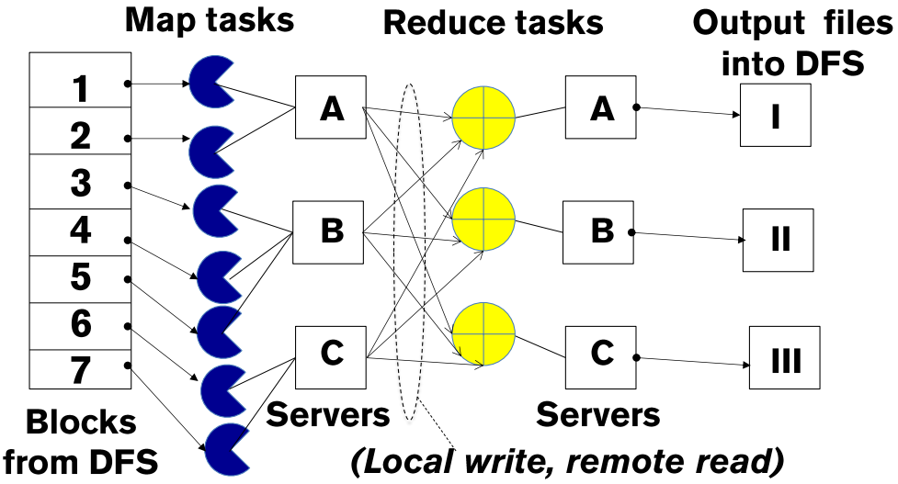
Inside MapReduce
Parallelize Map
Parallelize Reduce
Scheduling:
Assign Maps and Reduces to servers
Transfer data from Map to Reduce

Slide 23
The YARN Scheduler
Used in Hadoop 2.x +
YARN = Yet Another Resource Negotiator
Treats each server as a collection of containers
  Container = some CPU + some memory
Has 3 main components
  Global Resource Manager (RM)
    Scheduling
  Per-server Node Manager (NM)
    Daemon and server-specific functions
  Per-application (job) Application Master (AM)
    Container negotiation with RM and NMs
    Detecting task failures of that job
RM
Scheduler
1. Need container
2. Container completed
3. Container on Server B
What kind of algorithms used in scheduling?
Server A
Server B
NM
NM
4. Start task, please
AM 1
…
AM 2
Task (Container)

Slide 24
Why Scheduling?
Multiple “tasks” to schedule
  The processes on a single-core OS
  The tasks of a Hadoop job
  The tasks of multiple Hadoop jobs
Limited resources that these tasks require
  Processor(s)
  Memory
  (Less contentious) disk, network
Scheduling goals
  Good throughput or response time for tasks (or jobs)
  High utilization of resources

Slide 25
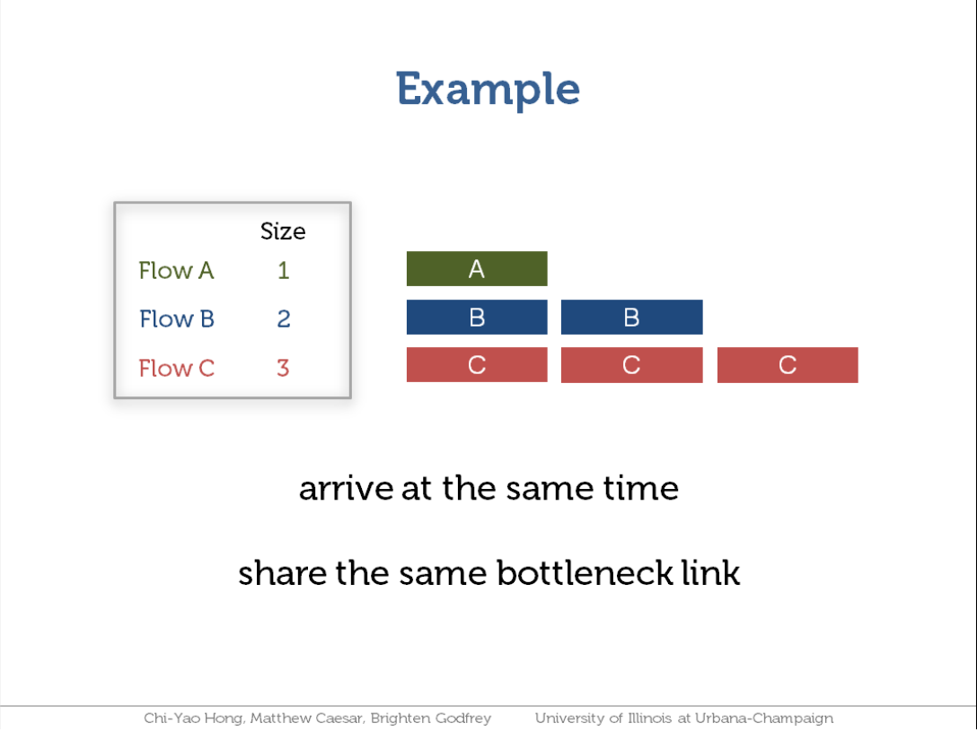

Slide 26
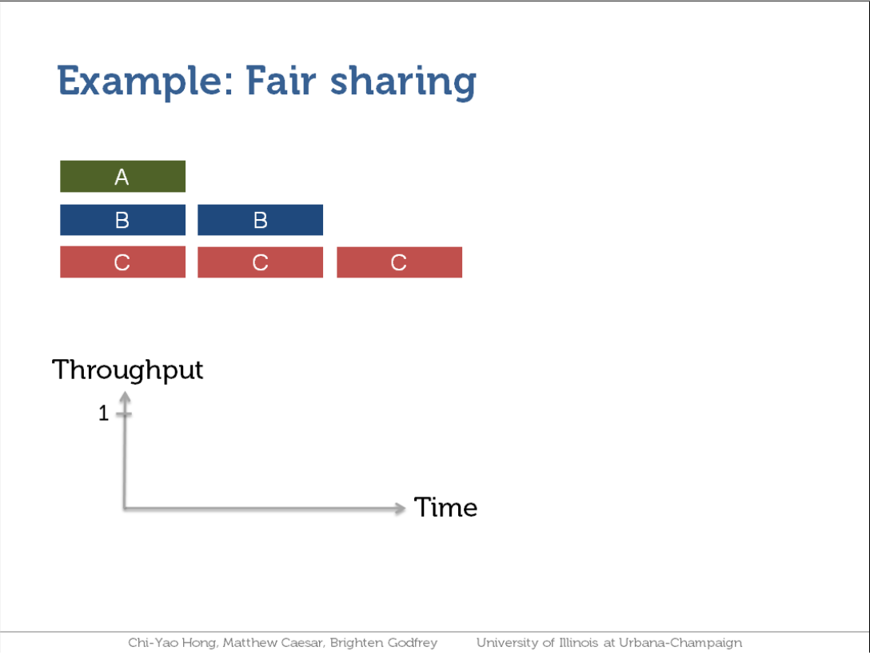

Slide 27
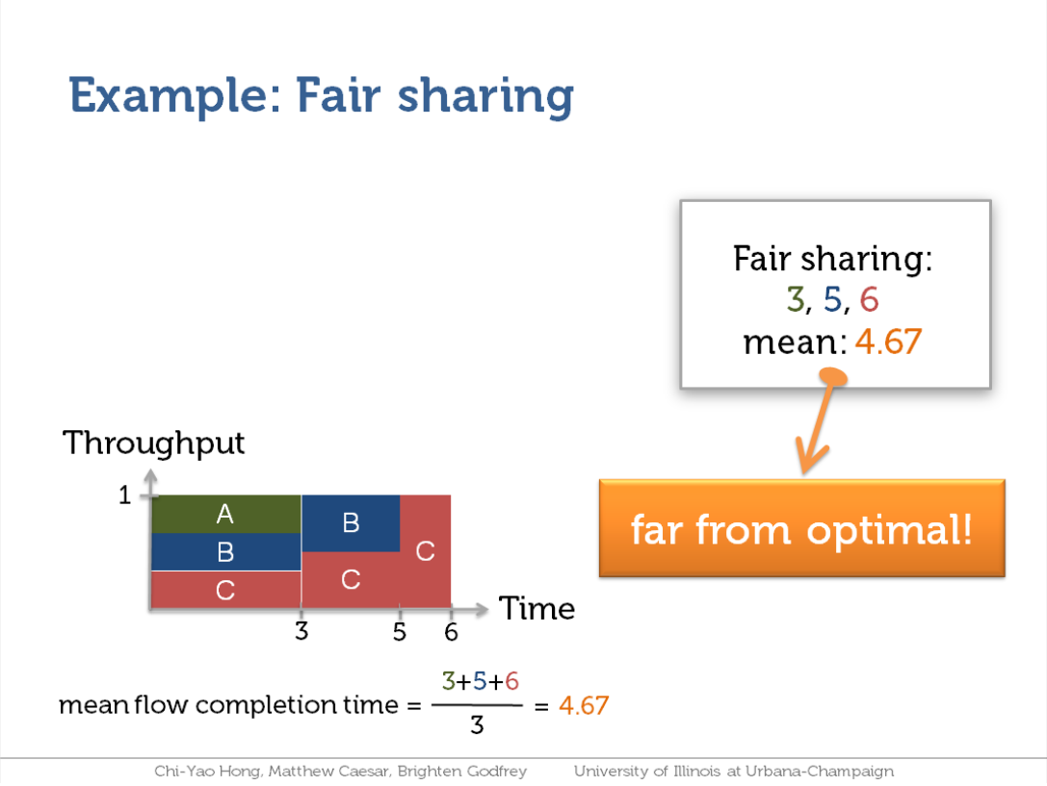

Slide 28
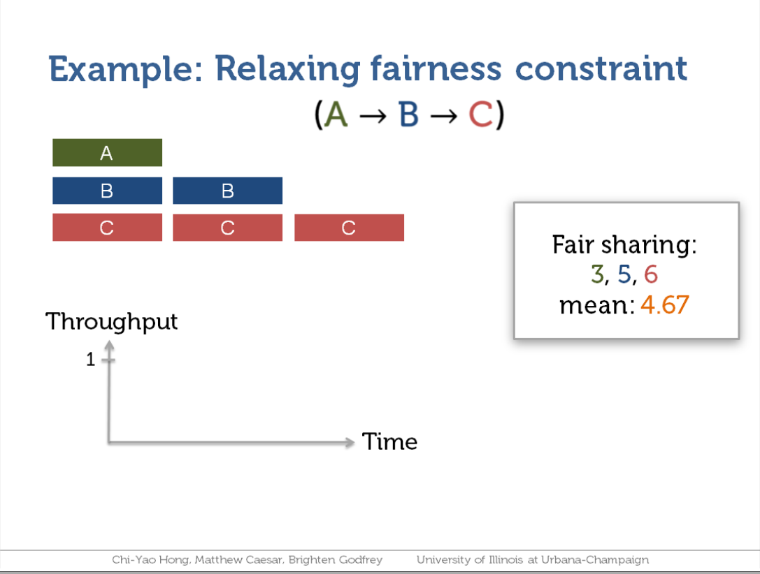

Slide 29
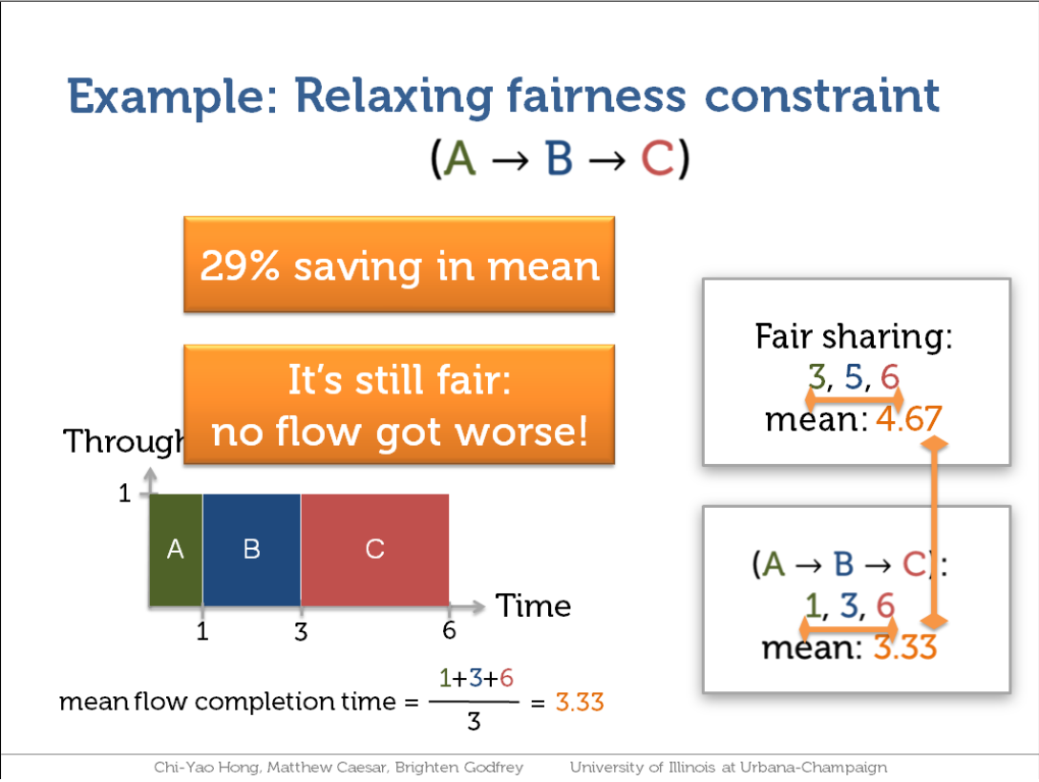

Slide 30
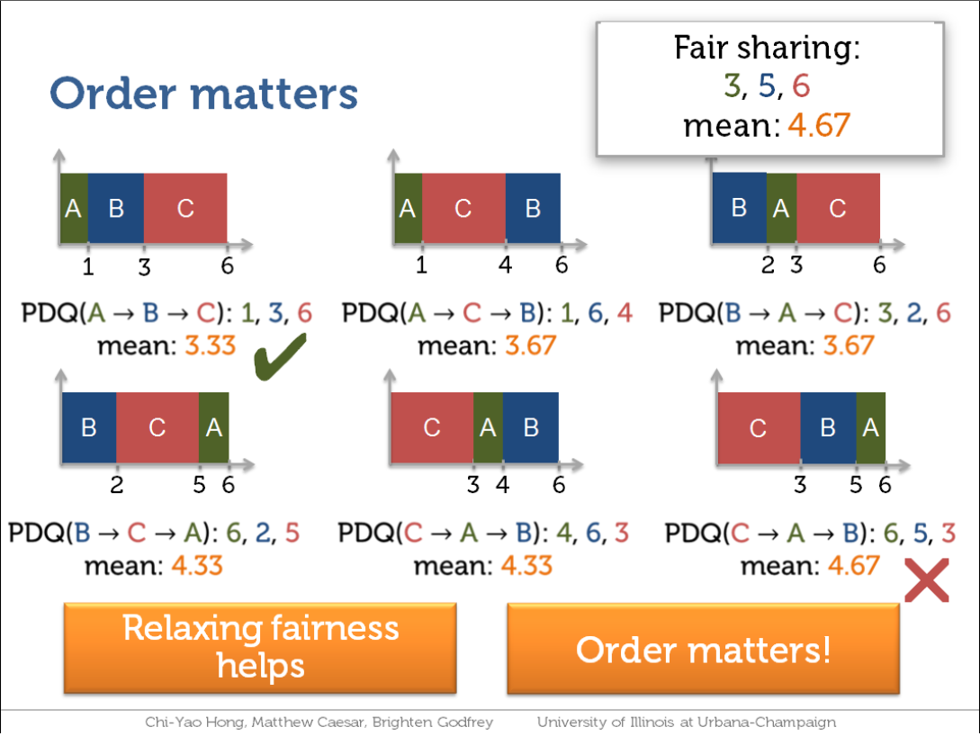
STF (Shortest Task First) is optimal!
A special case of priority scheduling

Slide 31
Outline
Paradigm
Examples
Scheduling
Fault-tolerance

Slide 32
Fault-tolerance
RM
Scheduler
Server failure
  NM heartbeats to RM
    If fails, RM notifies all affected AMs
  NM monitors tasks running at its server
    If fails, mark the task and restart it
  AM heartbeats to RM
    If fails, RM restarts AM, which then syncs up with its running tasks
RM failure
  Use old checkpoints and bring up secondary RM
Heartbeats also used to piggyback container requests
  Avoids extra messages
Server A
Server B
NM
NM
AM 1
…
AM 2
Task (Container)

Slide 33
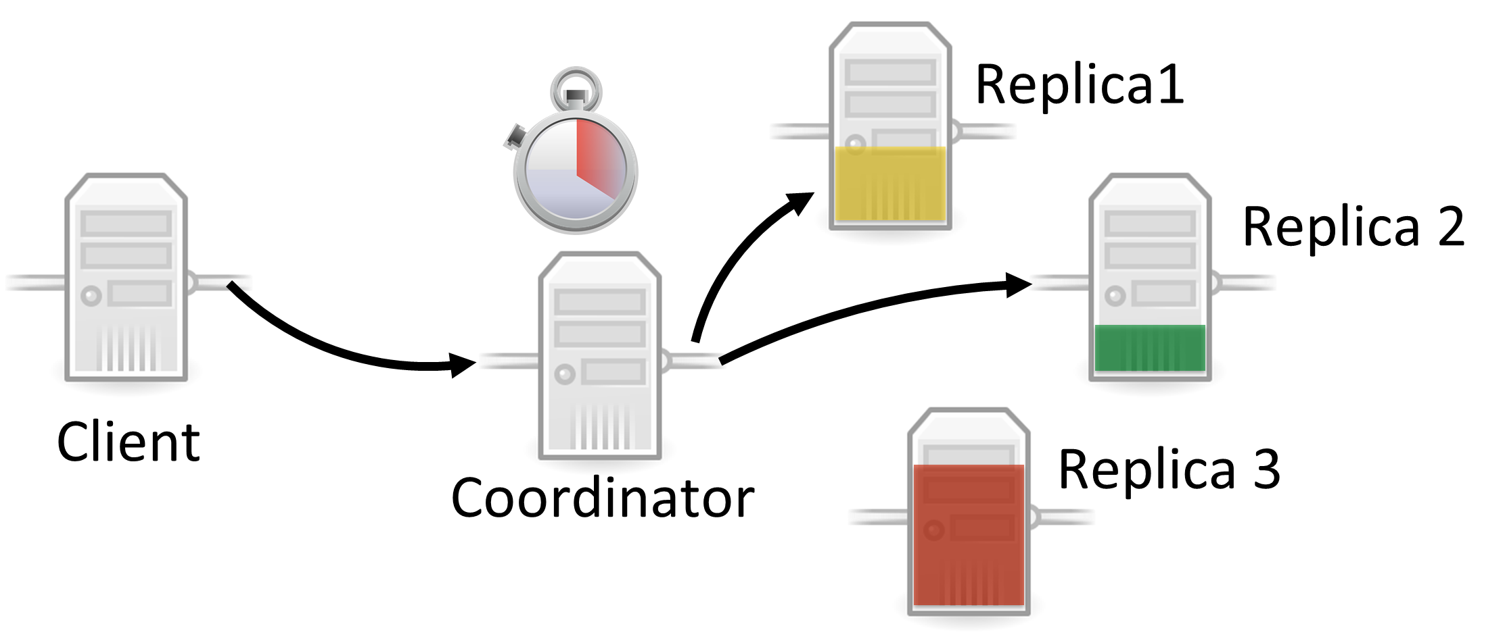
Slow Tasks (Stragglers)
The slowest machine slows the entire job down
Due to bad disk, network bandwidth, CPU, memory, etc.
Keep track of “progress” of each task
Perform backup (replicated) execution of straggler task

Slide 34
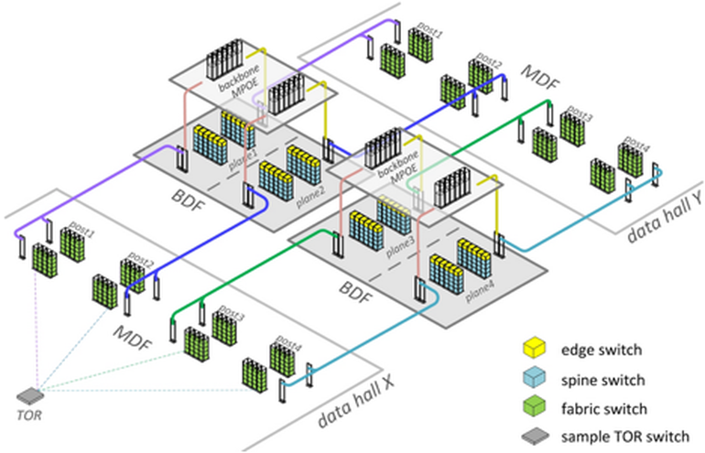
Locality
Cloud networking has hierarchical topology
  Racks, pods, cluster, datacenter, …
GFS/HDFS stores 3 replicas for each chunk
  Maybe on different racks
MapReduce tries to schedule a Map task using the following priority:
  Same machine containing the input data, if fail
  Same rack containing the input data, if fail
  Anywhere

Slide 35
MapReduce Summary
Paradigm
  Parallelization + Aggregation to deal with big data processing
Examples
  Word count, Dsitributed Grep, URL count, …
Scheduling
  For job: Maximize throughput, minimize latency
  For cloud: Maximize utilization
Fault-tolerance
  Need to be very careful about various failures

Slide 36
Thanks!
陈果 副教授
湖南大学-信息科学与工程学院-计算机与科学系
邮箱：guochen@hnu.edu.cn
个人主页：1989chenguo.github.io
https://1989chenguo.github.io/Courses/CloudComputing2018Spring.html

