Slide 1
Project Prizes
Select 3 best groups
Only for those groups that give presentations
Live voting from all audiences after presentation
Prizes
Three excellent books
About Microsoft, IoT & new industrial revolution, and Cyber economy
One book for each group
Groups chose the books in the order of their ranks

Slide 2
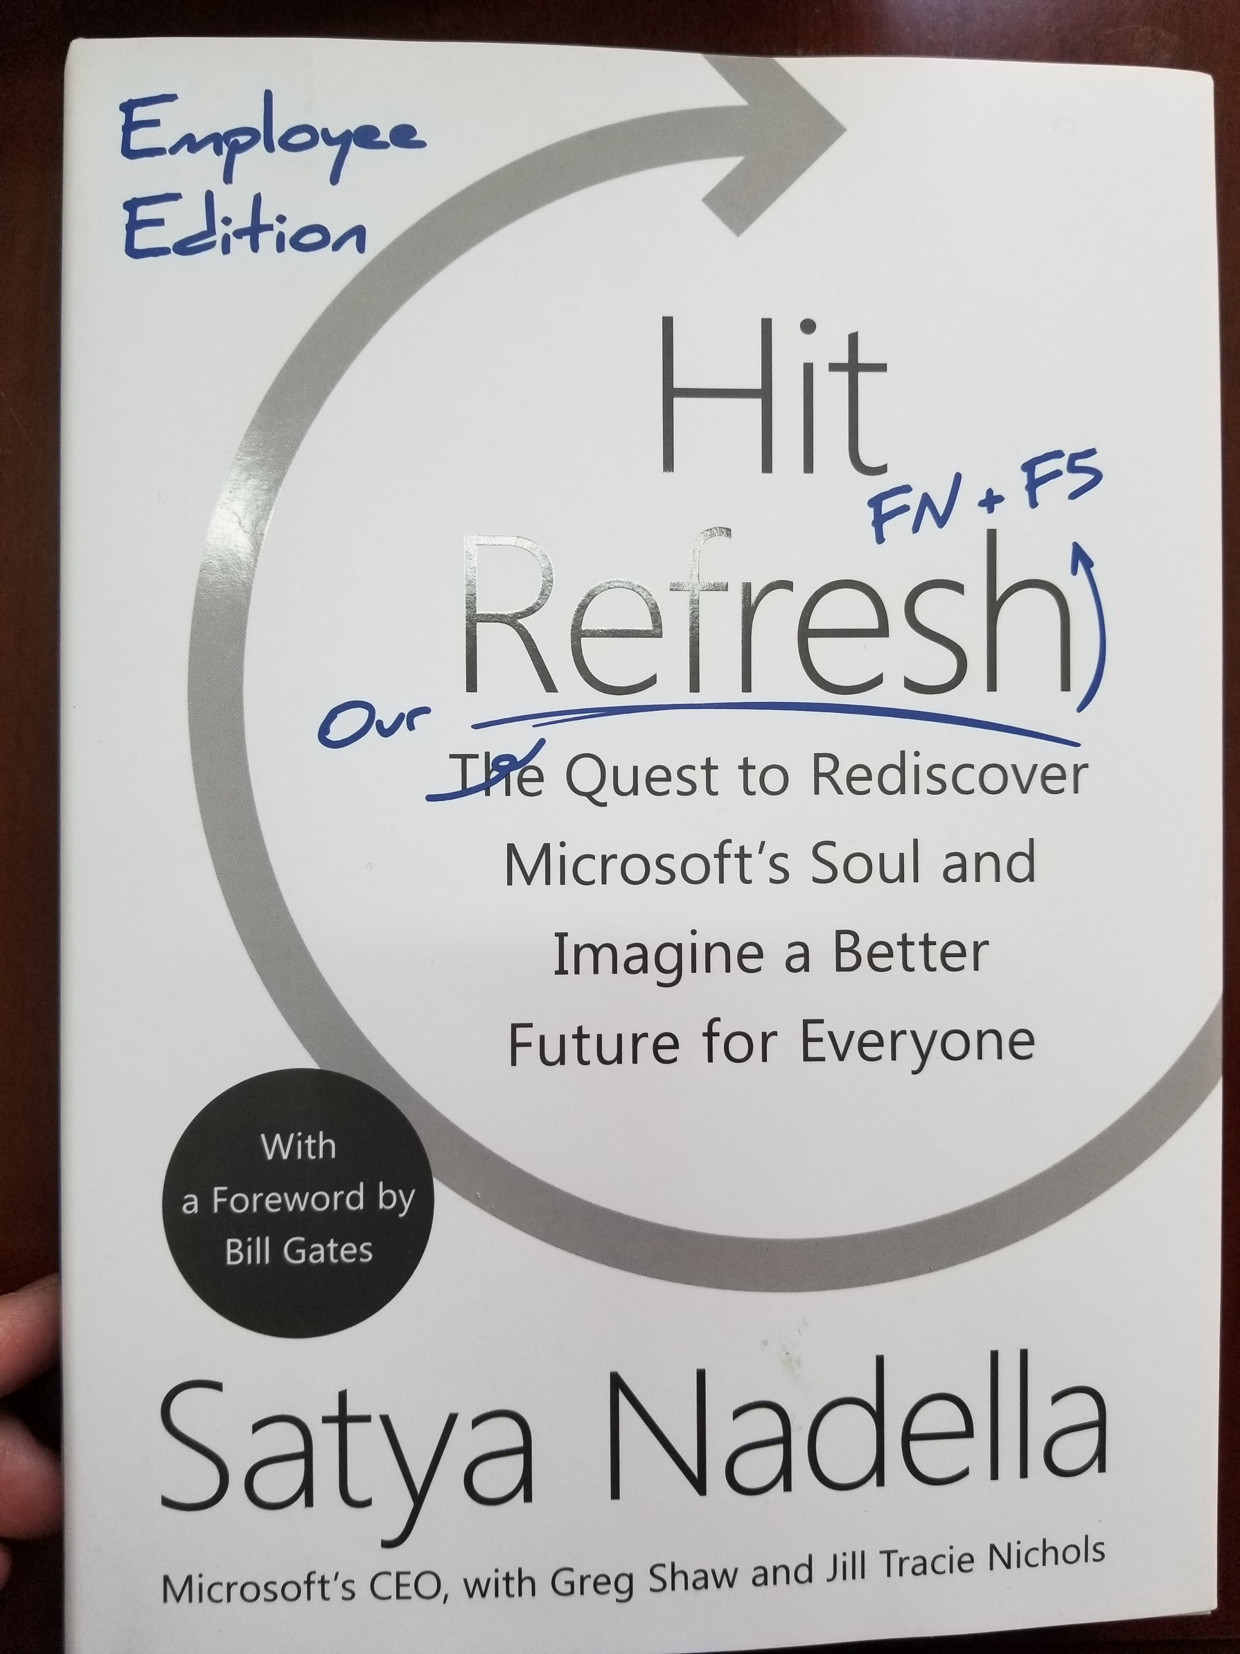
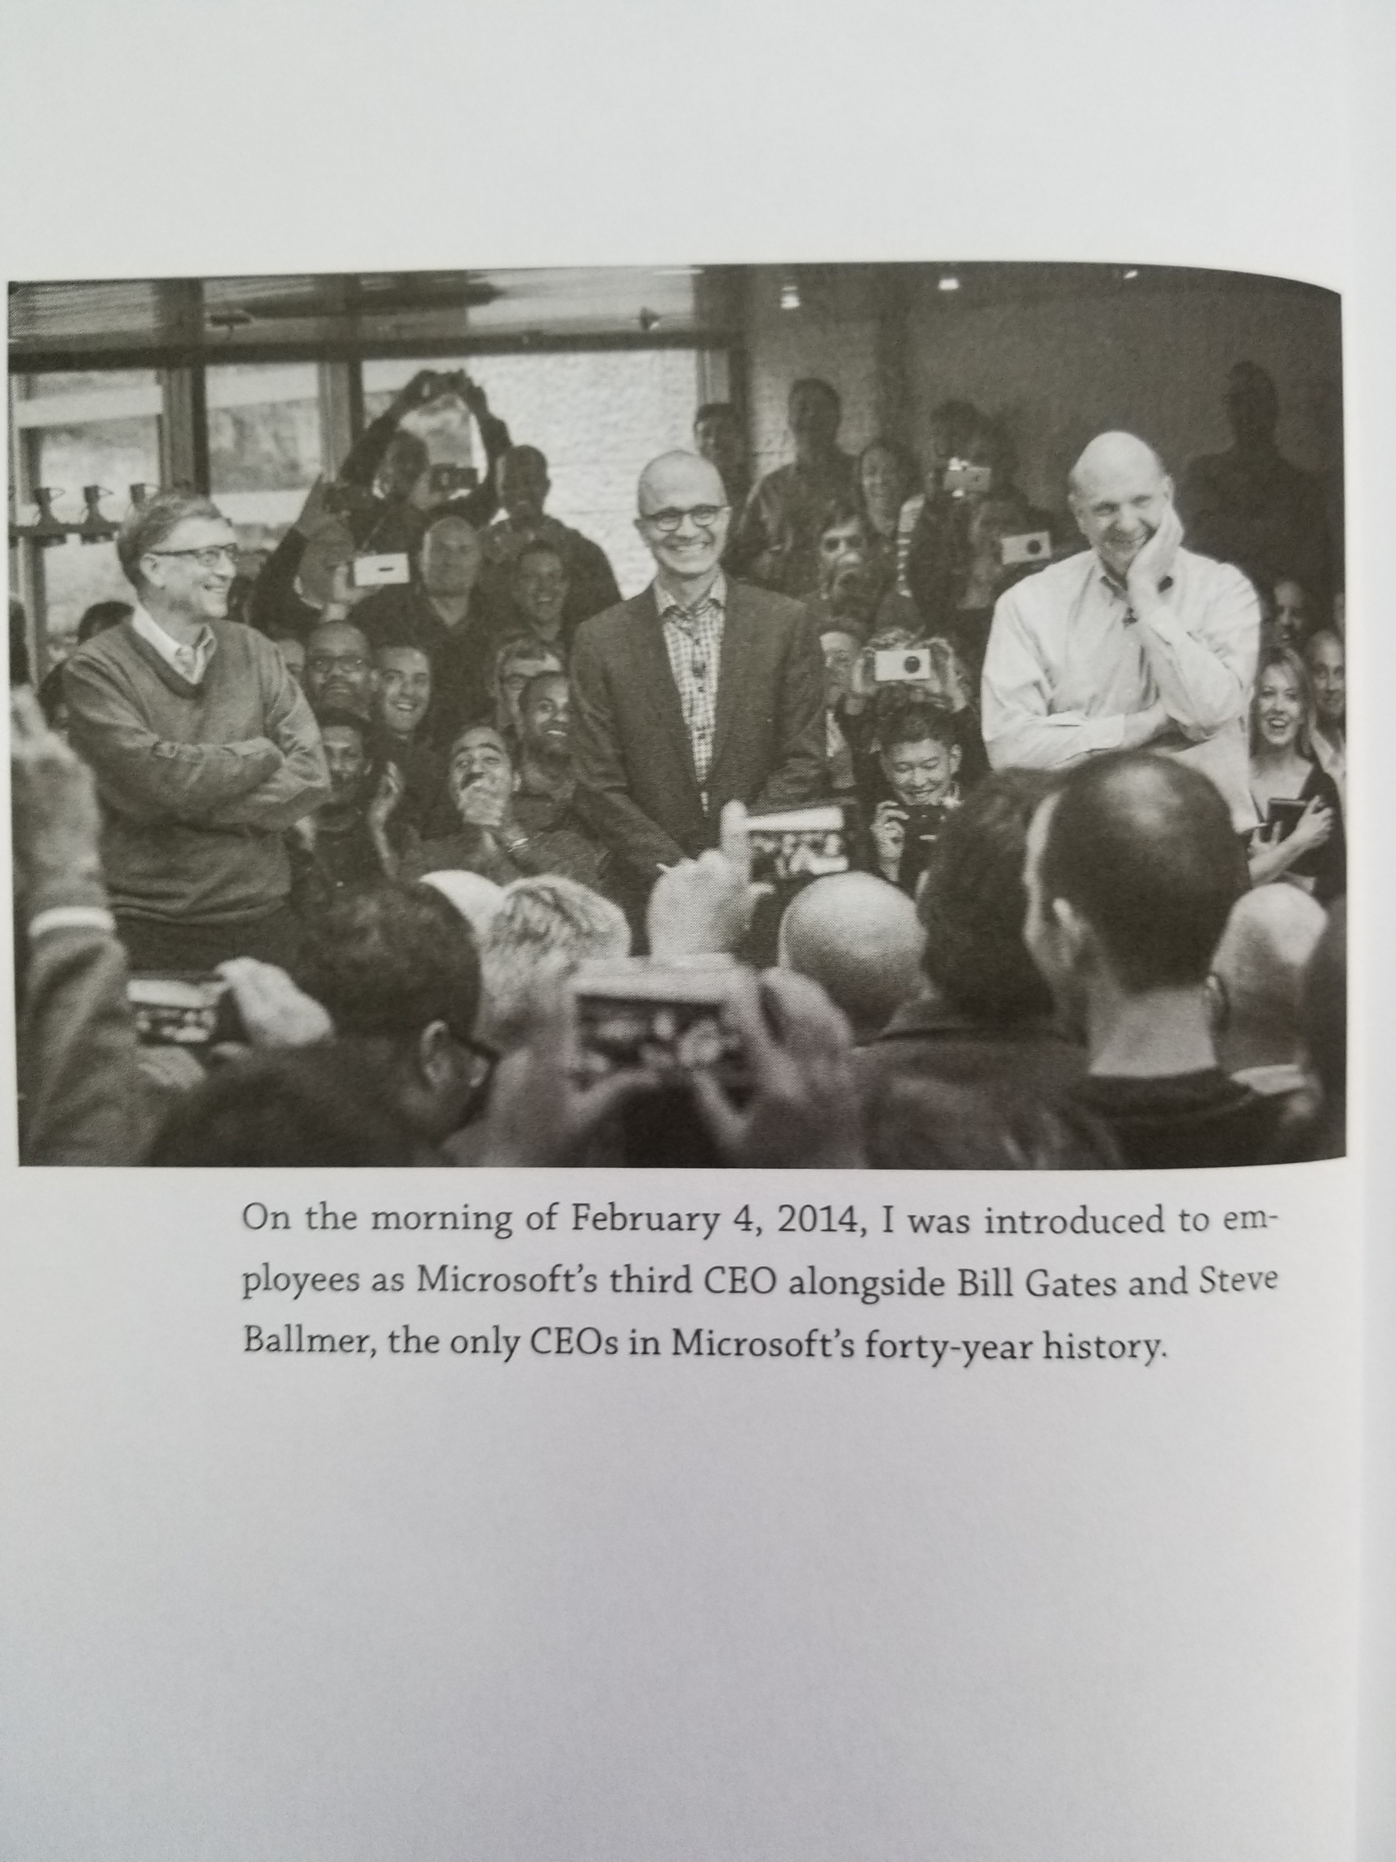
Book #1: Hit Refresh From Satya Nadella, Microsoft

Slide 3
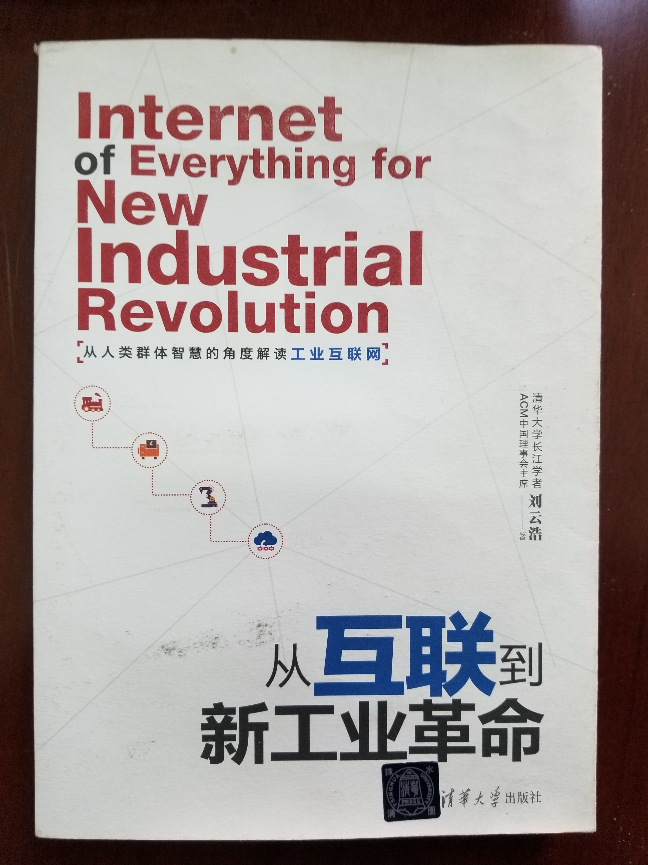
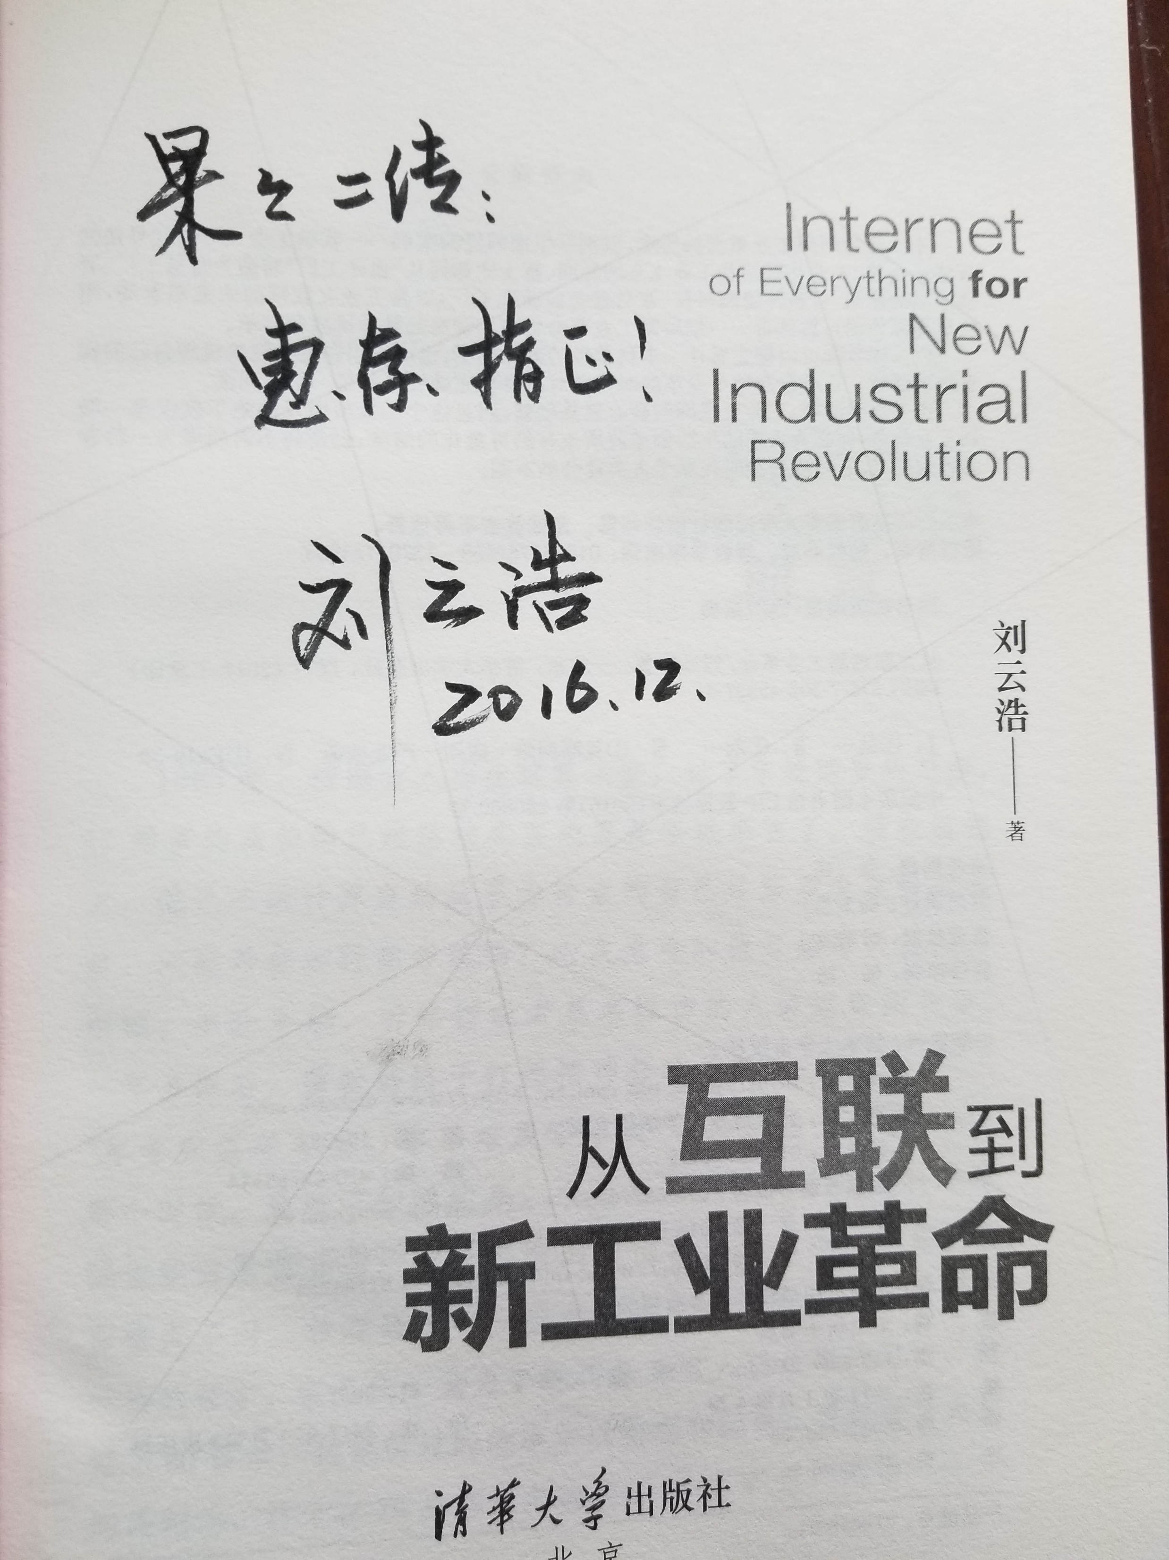
Book #2: 从互联到新工业革命 From 刘云浩, 清华大学/密歇根州立大学

Slide 4
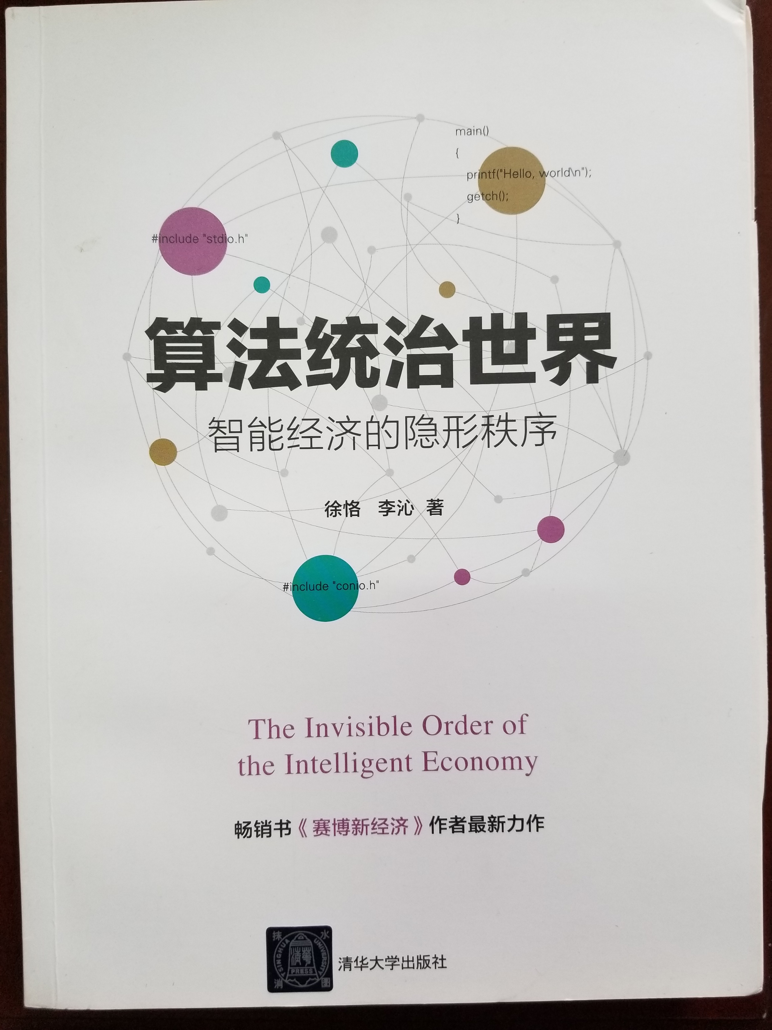
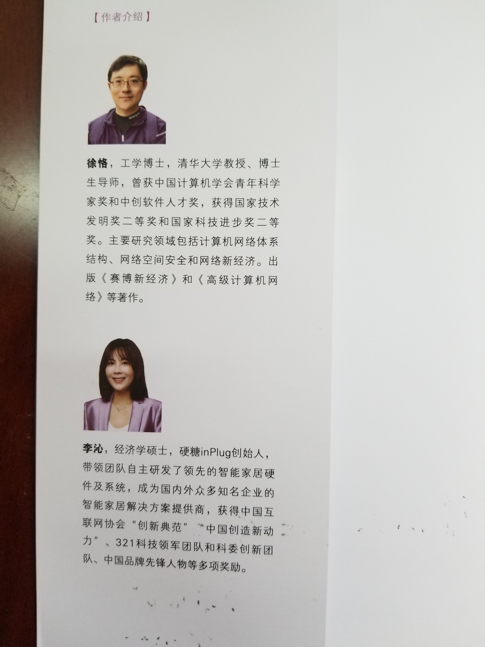
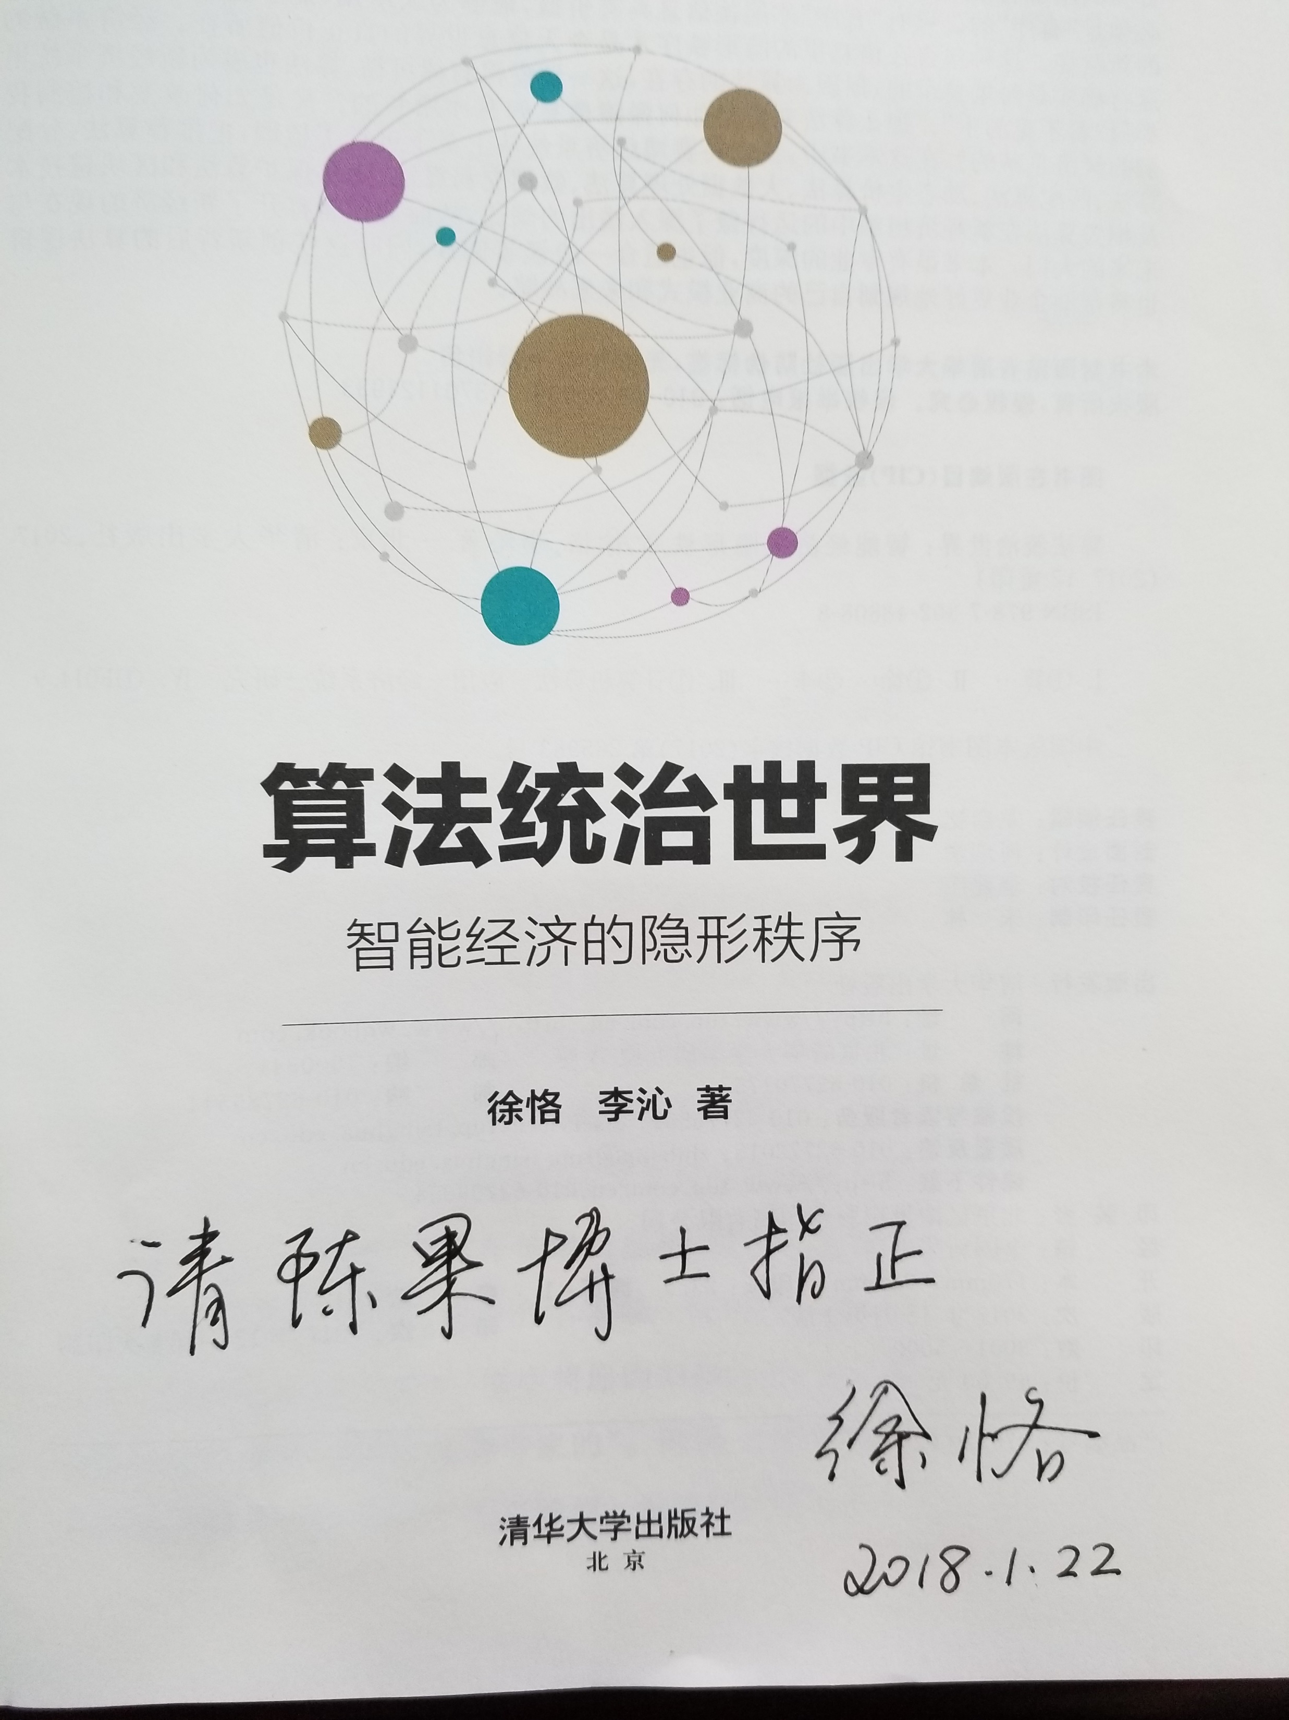
Book #3: 算法统治世界 From 徐恪, 清华大学；李沁，硬糖

Slide 5
Go and fight for the prize!

